Slide 1
Temporal Analysis of Groucho Mediated Gene Regulation in the Drosophila Embryo
Michael Chambers
Albert Courey Lab
July 2015

Slide 2
Overview
Establishing a timeline of Groucho activity in early embryonic development
Investigating the dynamics of Groucho occupancy

Slide 3
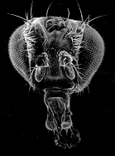
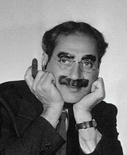
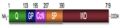
Groucho (Gro) Groucho Marx
groucho¹
groucho^{Marx}
groucho mutant results in extra supraorbital bristles
Gro
R
A
OFF
CRM

Slide 4
Gro mediates repression via interaction with DNA-bound repressors
Gro
TF
TF
Notes:
Groucho mediates long-range repression. The idea of long-range repression can be demonstrated in the following diagram. A transcription factor binds an CRM leading to a specific spatial expression pattern. An independent transcription factor binds to another enhancer element, at a distance of greater than 1 kb, and leads to a different specific spatial expression pattern. If Gro is recruited by one of these transcription factors, it can lead to the repression of all enhancer elements driving expression of the gene. This is in contrast to short-range repressors that mediate repression of single enhancer elements over a few hundred bps.

Slide 5
Gro mediates repression via interaction with DNA-bound repressor
Gro
TF
TF

Slide 6
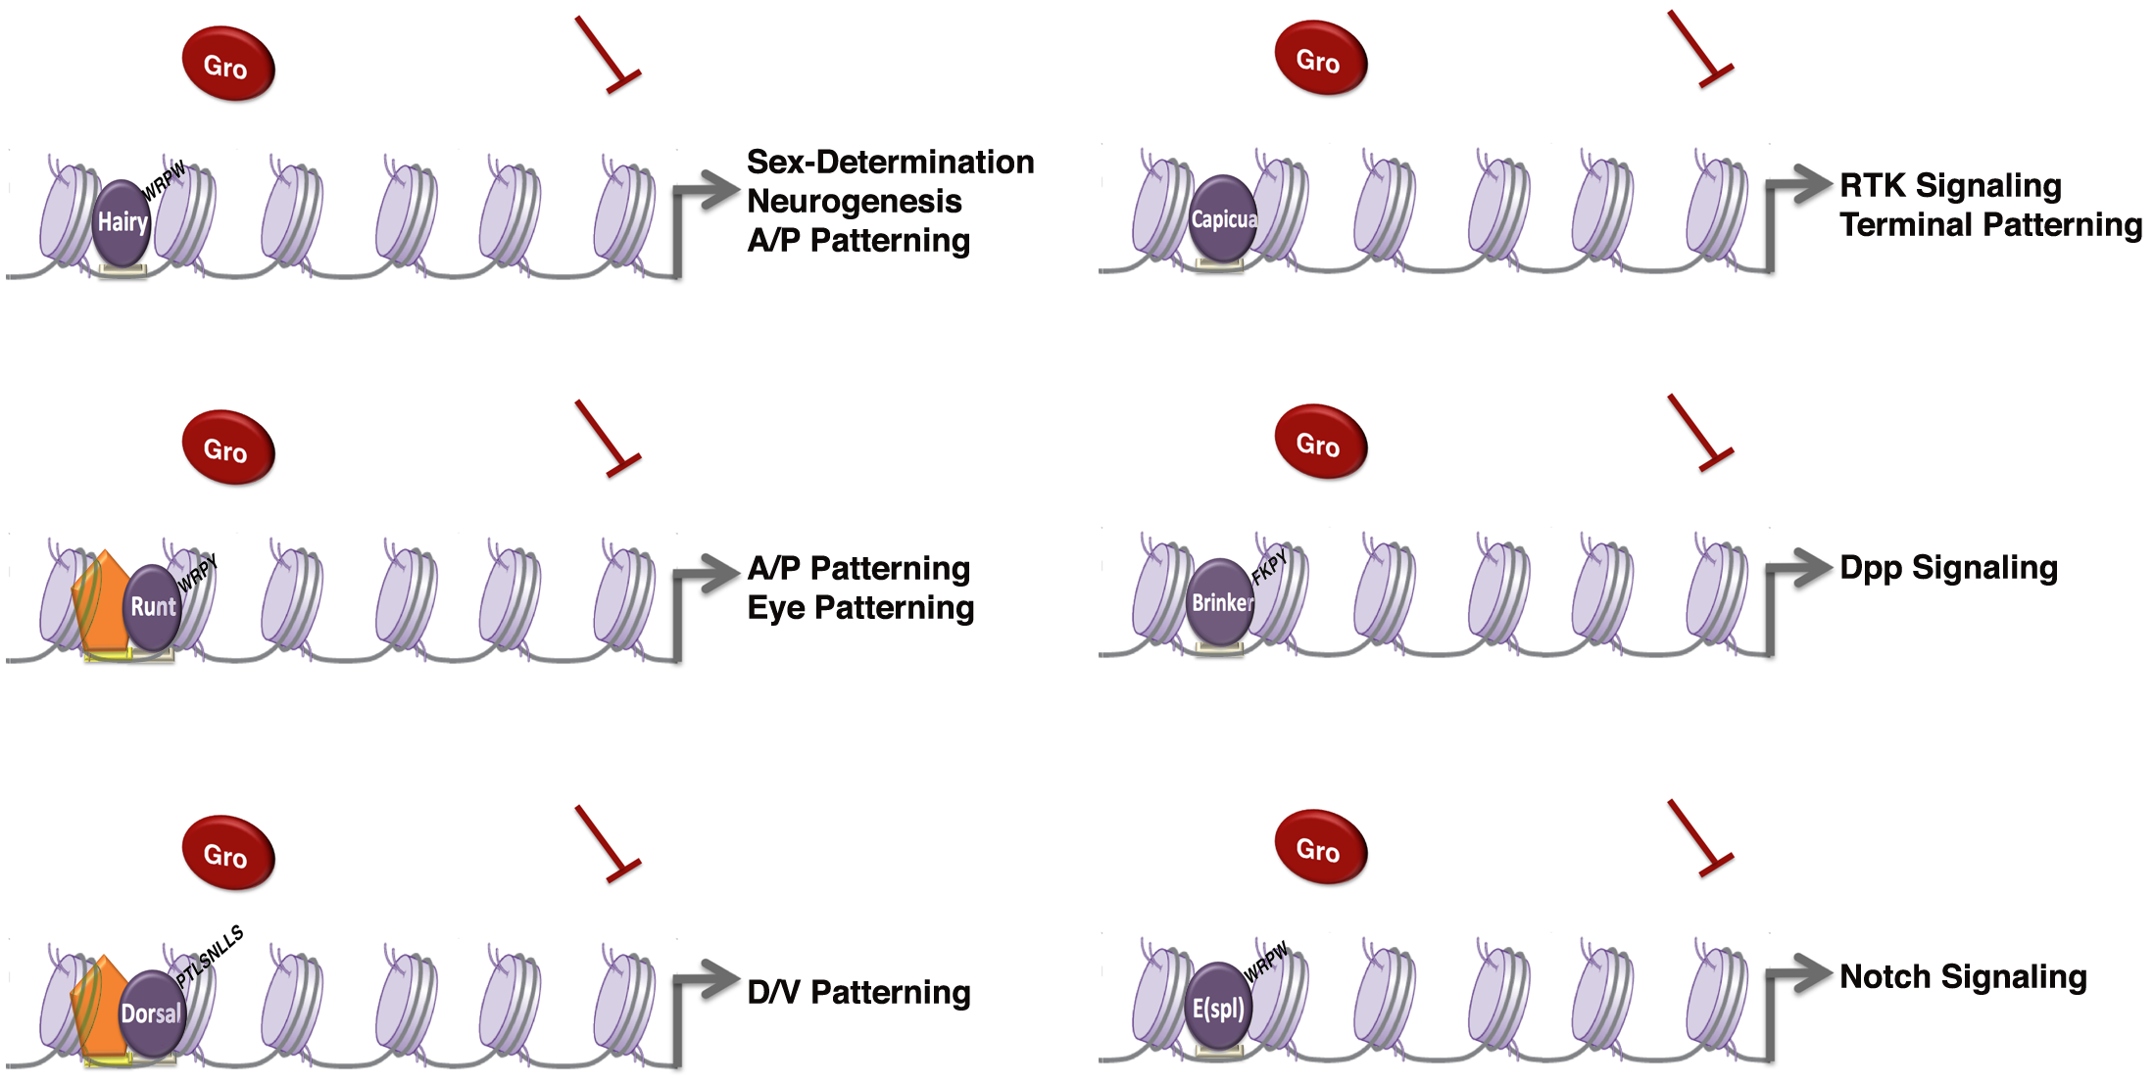
Groucho is required by many different DNA-bound repressors
image courtesy Wiam Turki-Judeh
Notes:
----- Meeting Notes (2/25/15 11:01) -----
Morphogen gradients
dorsal nfkb
hairy hes
runt aml
Tie into human homologs
capicua hmg box family

Slide 7
There is evidence for multiple mechanisms of Gro mediated repression
Seikya and Zaret, 2007
Zhang and Emmons, 2002
Cai et al, 2003
Figures Turki-Judeh and Courey, 2012
Notes:
Add courey reference
unc-37 genetic interaction with MED1 and MED12 (SOP1 and SOP3 in C elegans)
Mention chromatin condensation
----- Meeting Notes (5/30/13 12:52) -----
Title: There is evidence for multiple mechanisms of Gro mediated repression
----- Meeting Notes (3/19/14 14:01) -----
Long range vs short range repression
----- Meeting Notes (2/25/15 11:01) -----
Mediator is tenuous
Animate
----- Meeting Notes (3/2/15 14:31) -----
use primary paper
chen et al
winkler et al
mol cell ken zarat

Slide 8
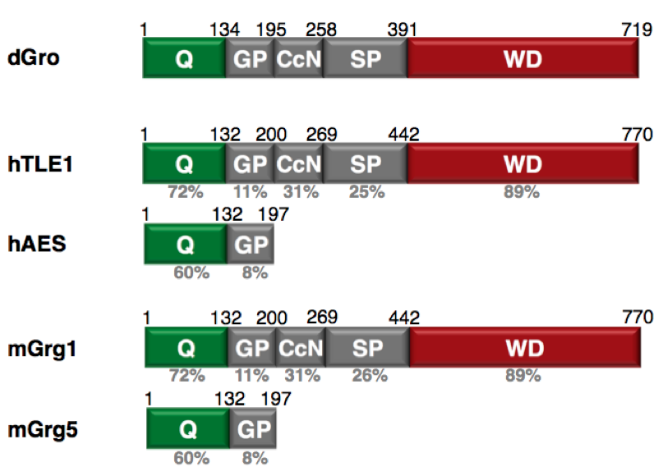
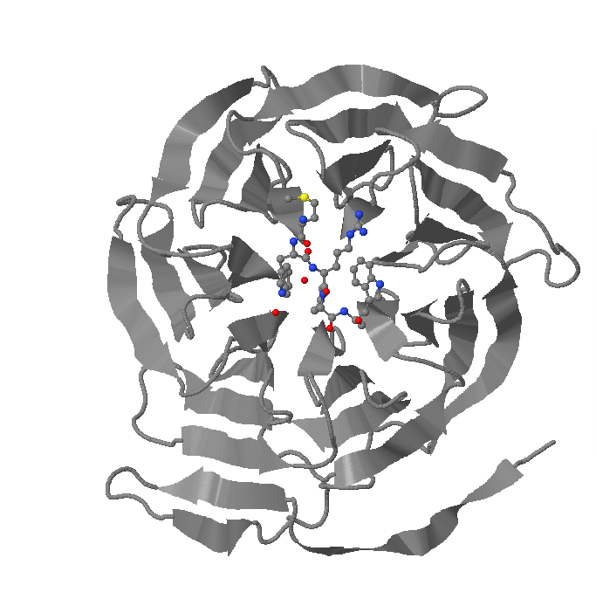
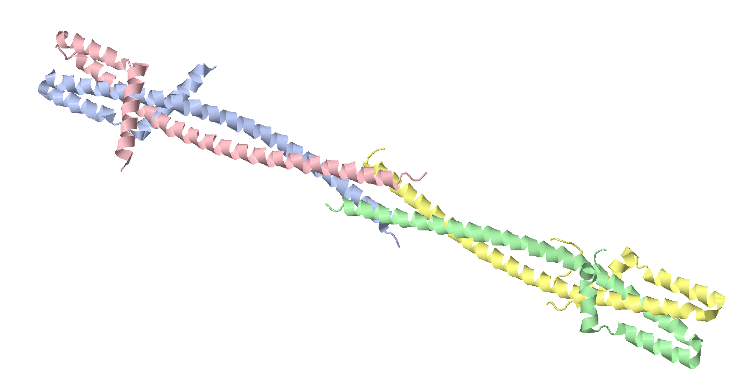
Groucho/TLE family proteins are highly conserved throughout metazoans
Oligomerization
Regulation
Protein interaction
Repressor Interaction
Notes:
----- Meeting Notes (5/30/13 12:52) -----
XTitle: Groucho is conserved throughout metazoans
----- Meeting Notes (2/25/15 11:01) -----
Q domain structure
WD domain structure
Remove mouse
Mention multiple human isoforms and dominant negative form
----- Meeting Notes (3/2/15 14:31) -----
wd repeat domain w peptide bound

Slide 9
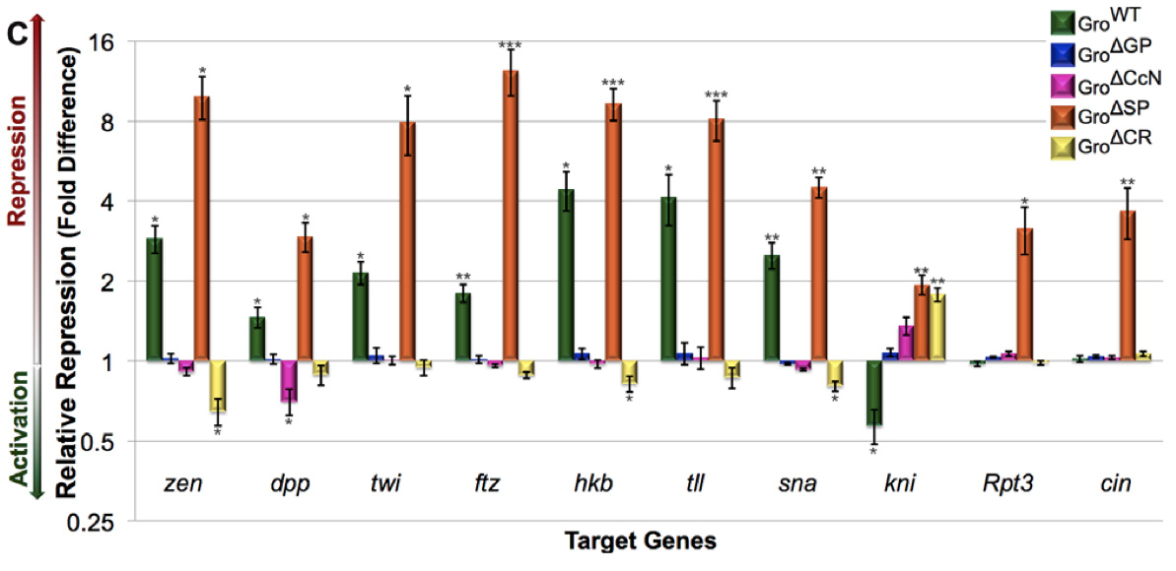
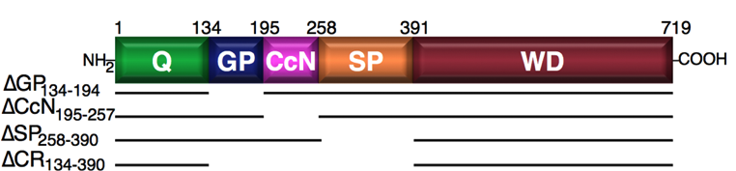
The central regions of Gro have roles in repression, Gro down-regulation, and target specificity
Turki-Judeh and Courey, 2012
Notes:
Point out repressor of repressors (knirps is repressed by tailless, which is repressed by Gro)
dSP potentially makes Gro a promiscuous activator, as it represses knirps, a non-target gene, as well as its regulator tll)
Applying this sort of analysis genome wide required the use of RNA-seq
0-3 hr embryos
----- Meeting Notes (5/30/13 12:52) -----
function -> repression
Smaller graph
Show diagram of mutations (or on previous slide)
Be sure to describe experiment before results
----- Meeting Notes (3/2/15 14:31) -----
Mention most Gro targets are repressed
Mention activated genes (2ndary targets)
IMportant for RNA-seq data

Slide 10
Overview
Establishing a timeline of Groucho activity in early embryonic development
Investigating the dynamics of Groucho occupancy

Slide 11


Genomic scale analysis will provide significant insight into Groucho’s functions in early fly development
Embryo
24 hr
Larva
4 days
Pupae
5 days
Adult
RNA-seq
Nascent-seq
ChIP-seq
mRNA accumulation
mRNA transcription rate
Groucho binding
Notes:
nascent-seq: Distribution of ternary elongation complexes
----- Meeting Notes (5/30/13 12:52) -----
Genome-wide instead of genomic scale
24 hr embryogenesis
Pupal 5 days ?
Histone marks under chip-seq

Slide 12
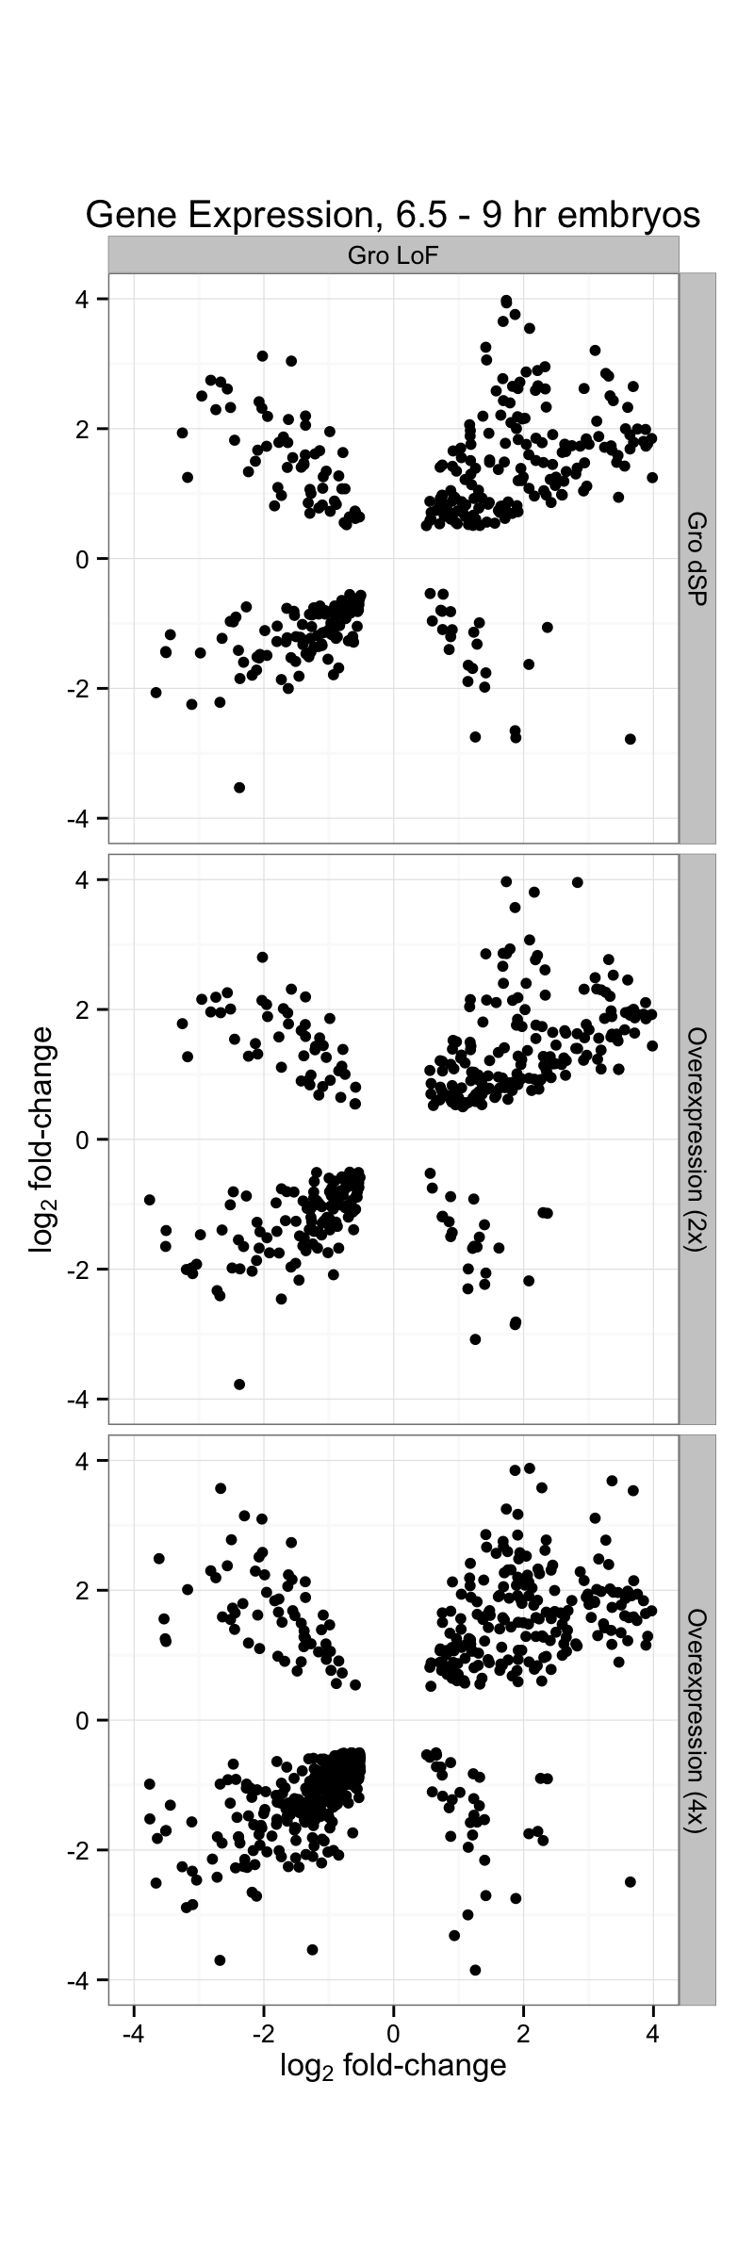
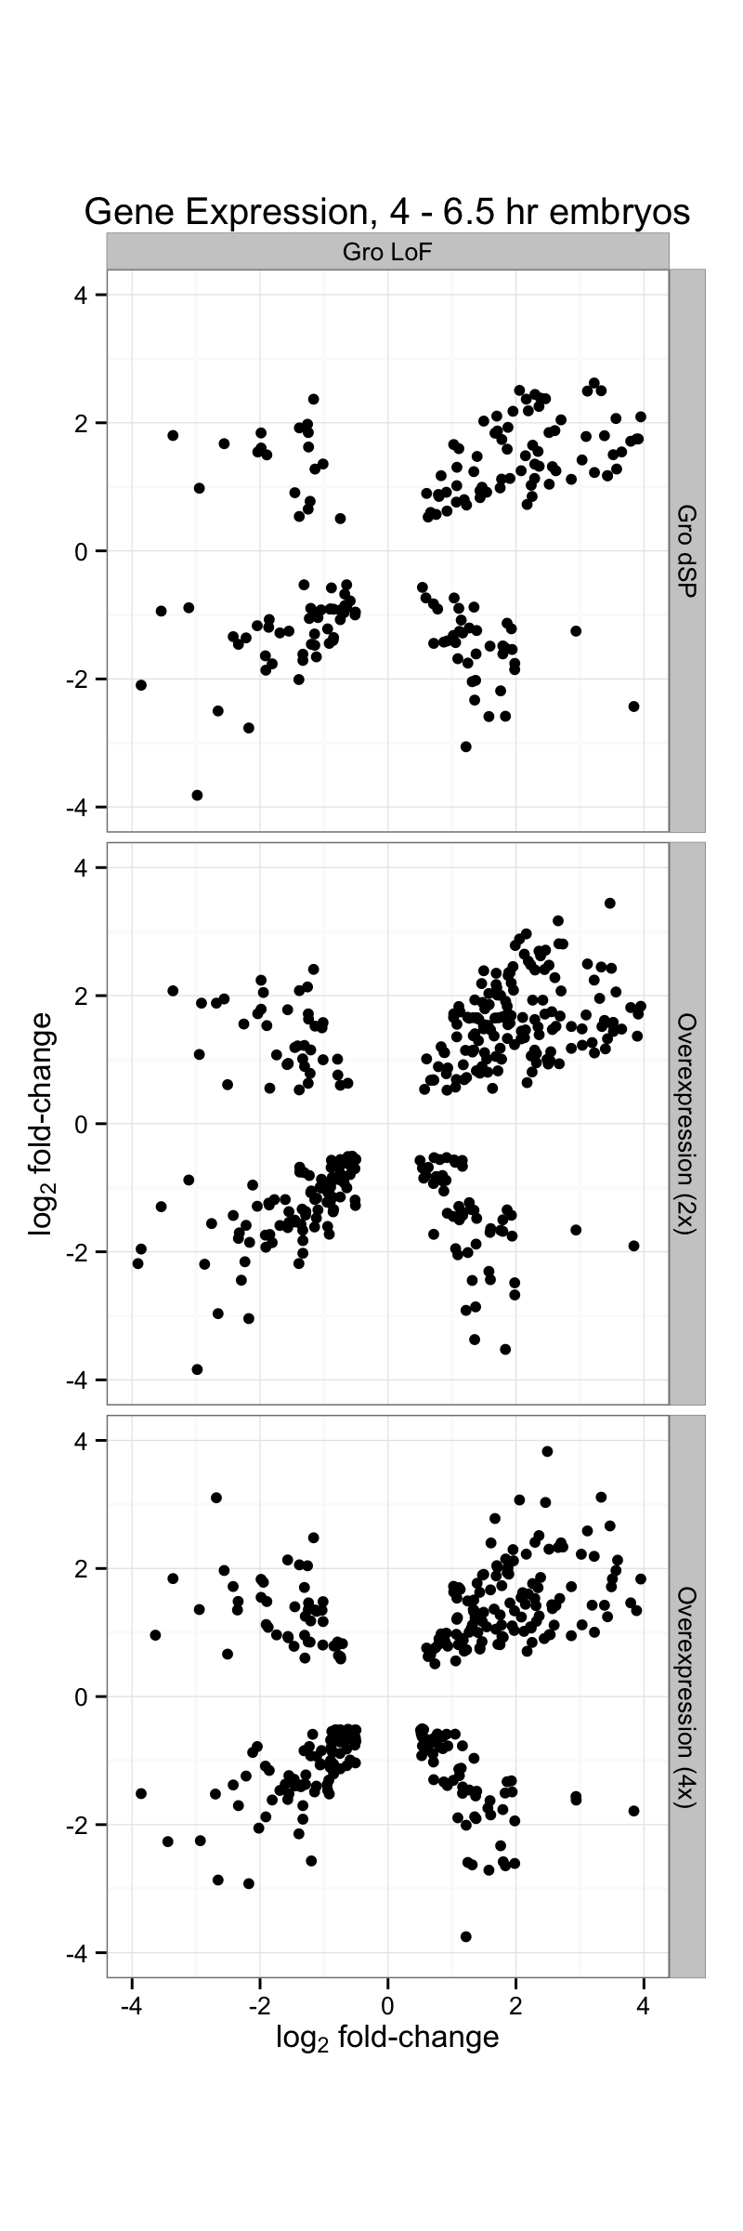
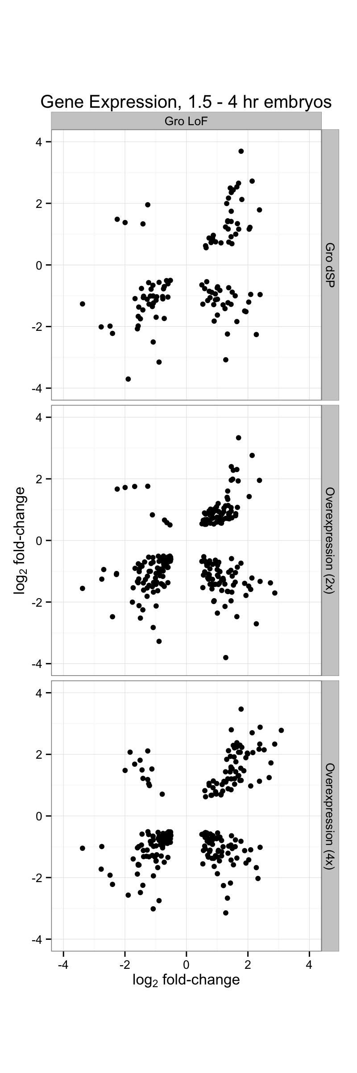
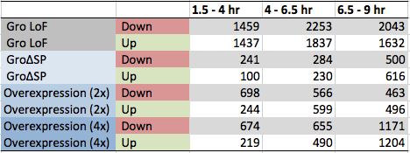
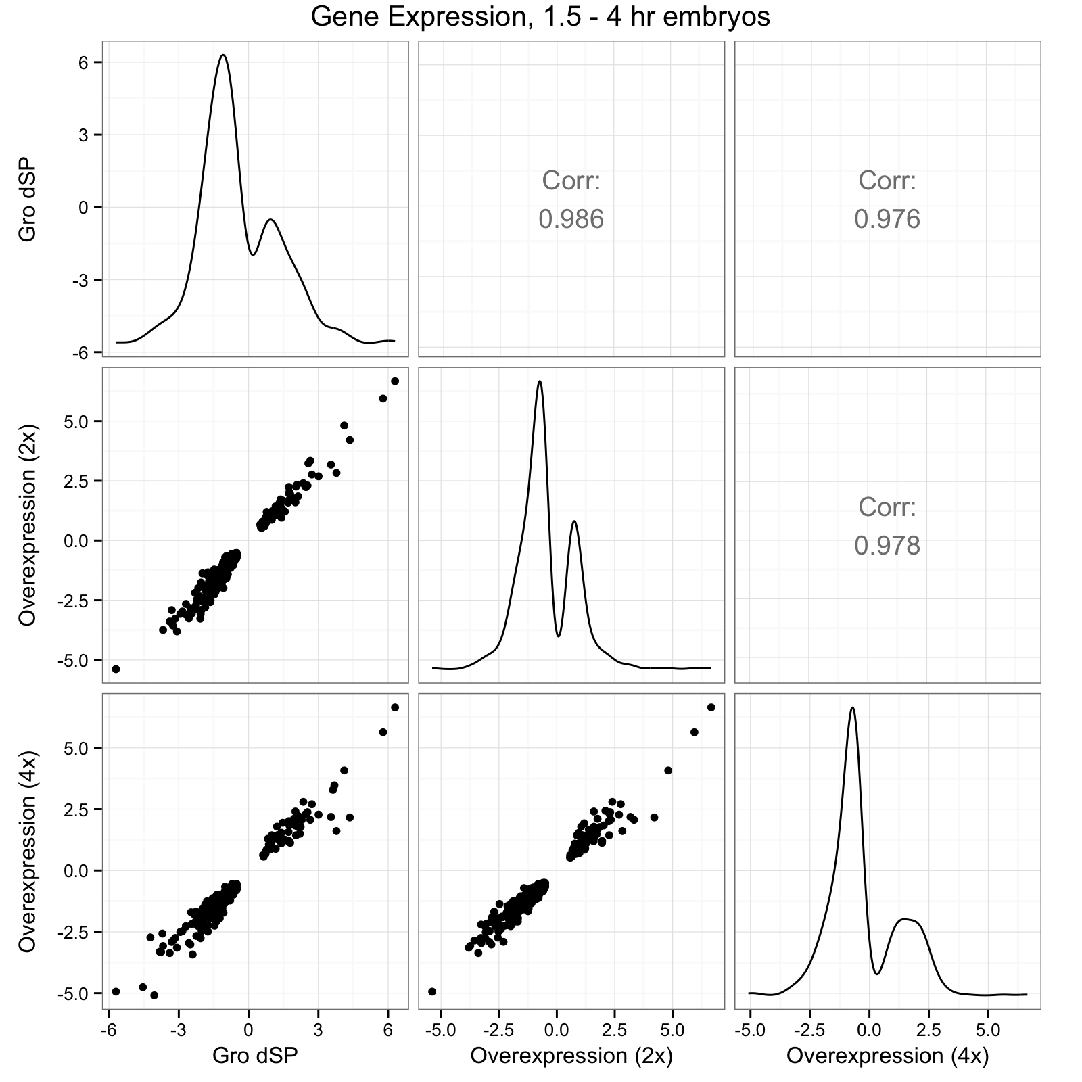
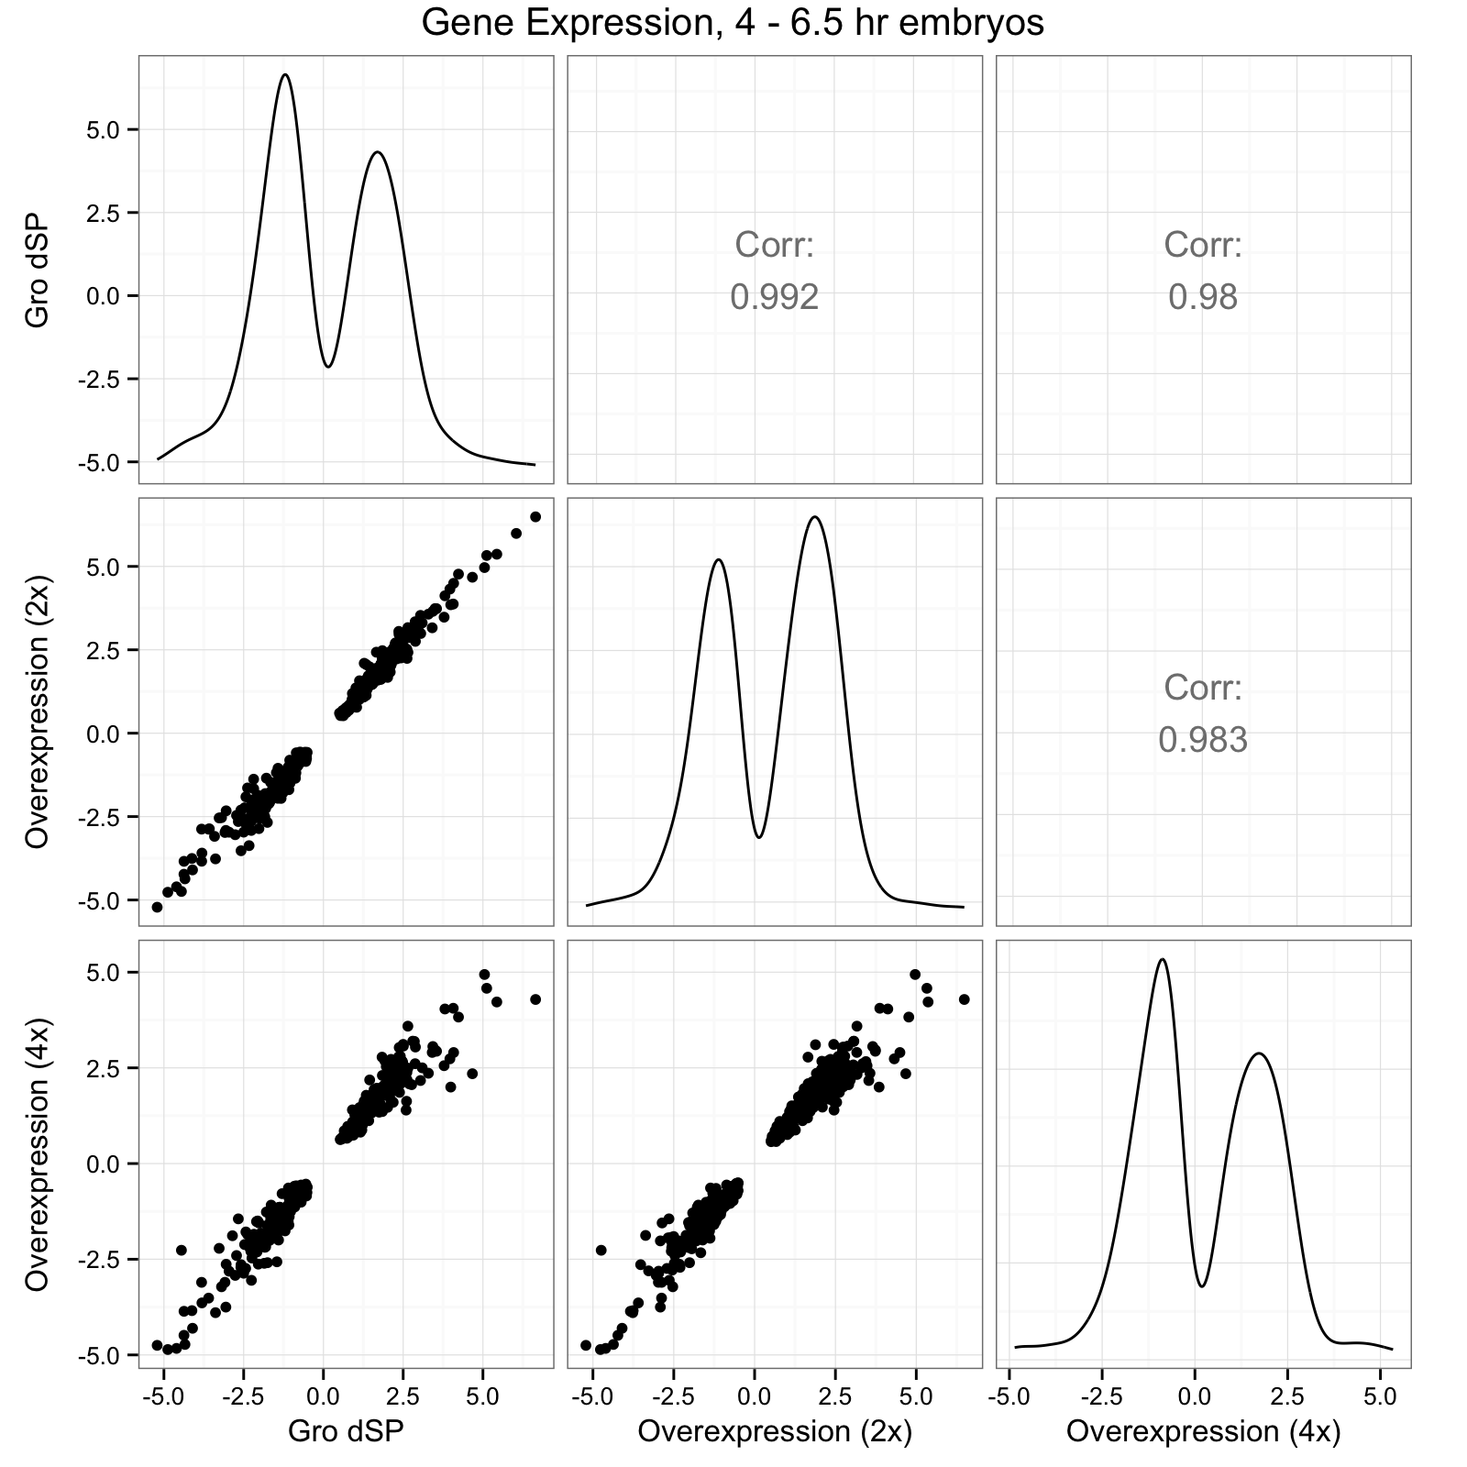
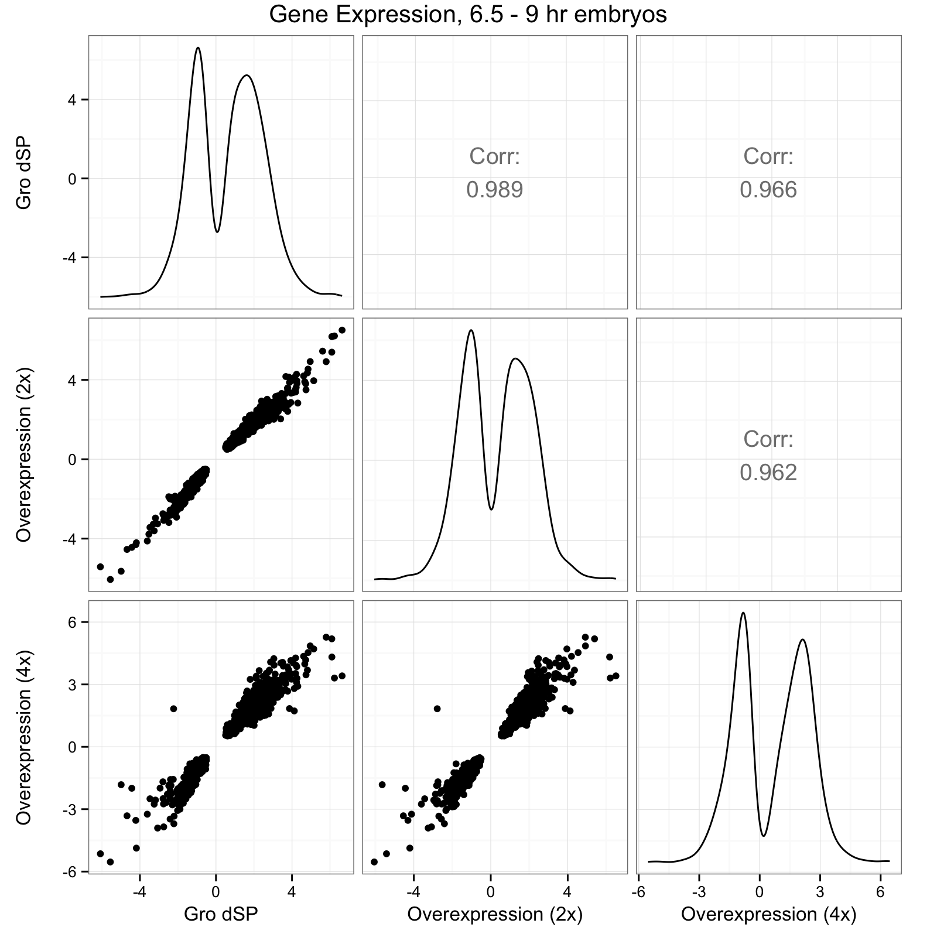
Perturbation of Groucho expression results in the misregulation of hundreds of genes
Notes:
Bottom left: bolder axes labels
Remove dSP
----- Meeting Notes (2/25/15 11:01) -----
Potentially bring in lof data first, oe later

Slide 13
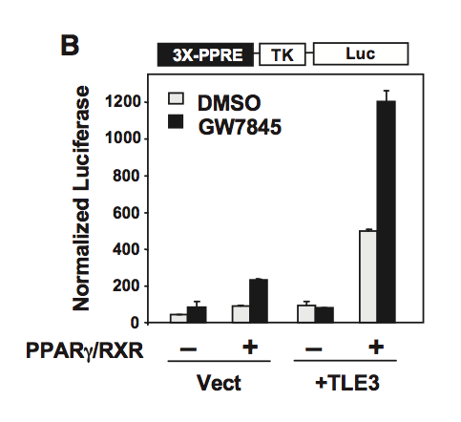
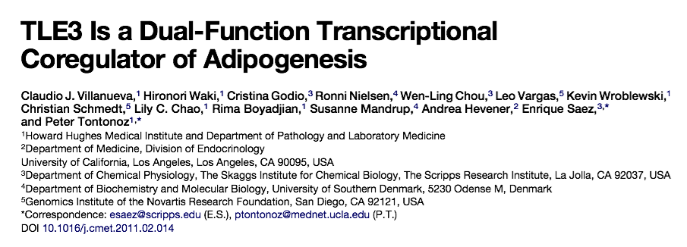
Cell Metabolism, 2011
Notes:
bibliographic information
One convincing result from the paper

Slide 14
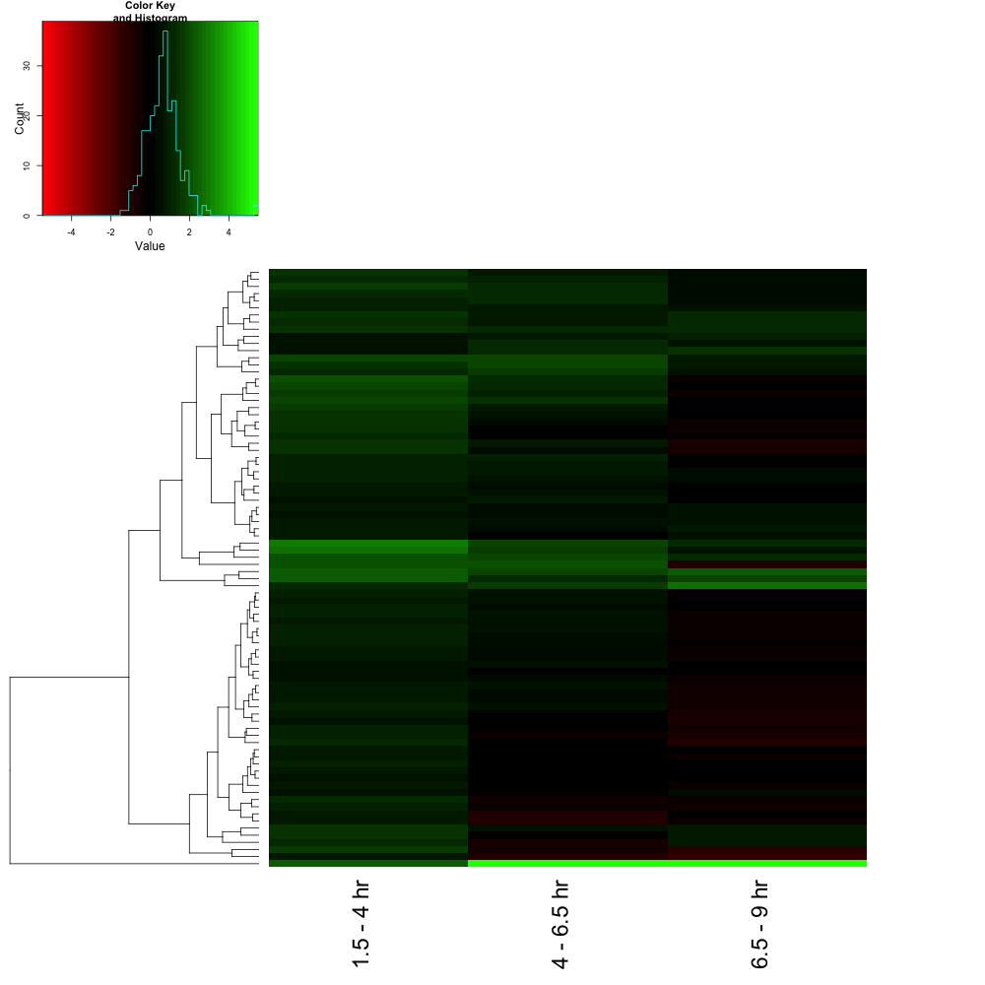
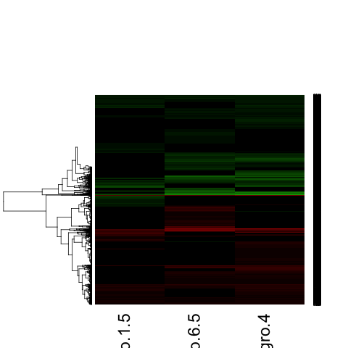
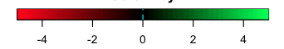
RNA-seq suggests Gro is a dedicated repressor in Drosophila
Differentially expressed genes
(Gro LoF)
Differentially expressed genes
(Gro LoF & Gro overexpression)
Notes:
----- Meeting Notes (3/2/15 14:37) -----
Integrate Tontonoz lab paper (title or abstract) before this slide (show title and type out last sentence of abstract)
Title: RNA-seq suggests Gro is a dedicated repressor in Drosophila

Slide 15
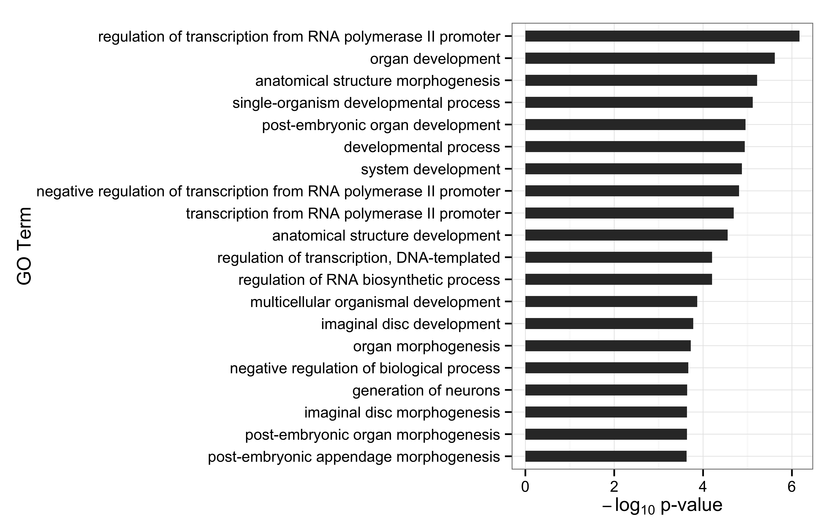
Putative Groucho target genes are enriched for developmentally-regulated TFs
Notes:
----- Meeting Notes (3/2/15 15:03) -----
Fonts darker and larger

Slide 16
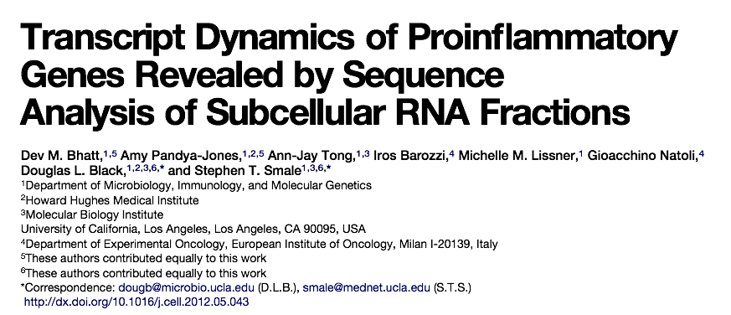
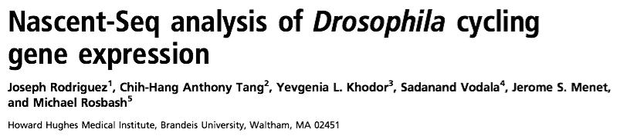
Nascent-seq provides a more accurate measurement of transcription rates in dynamic systems

Slide 17
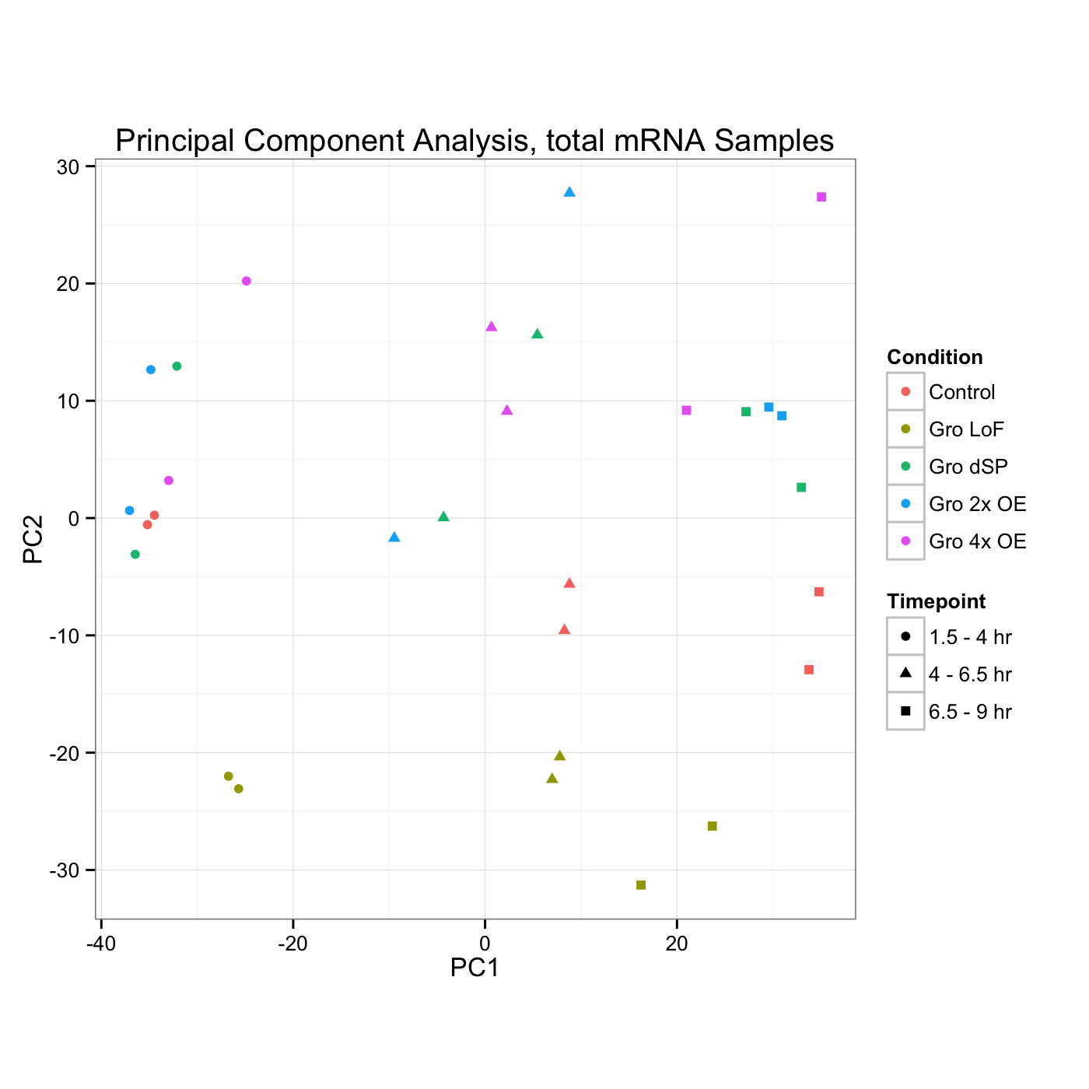
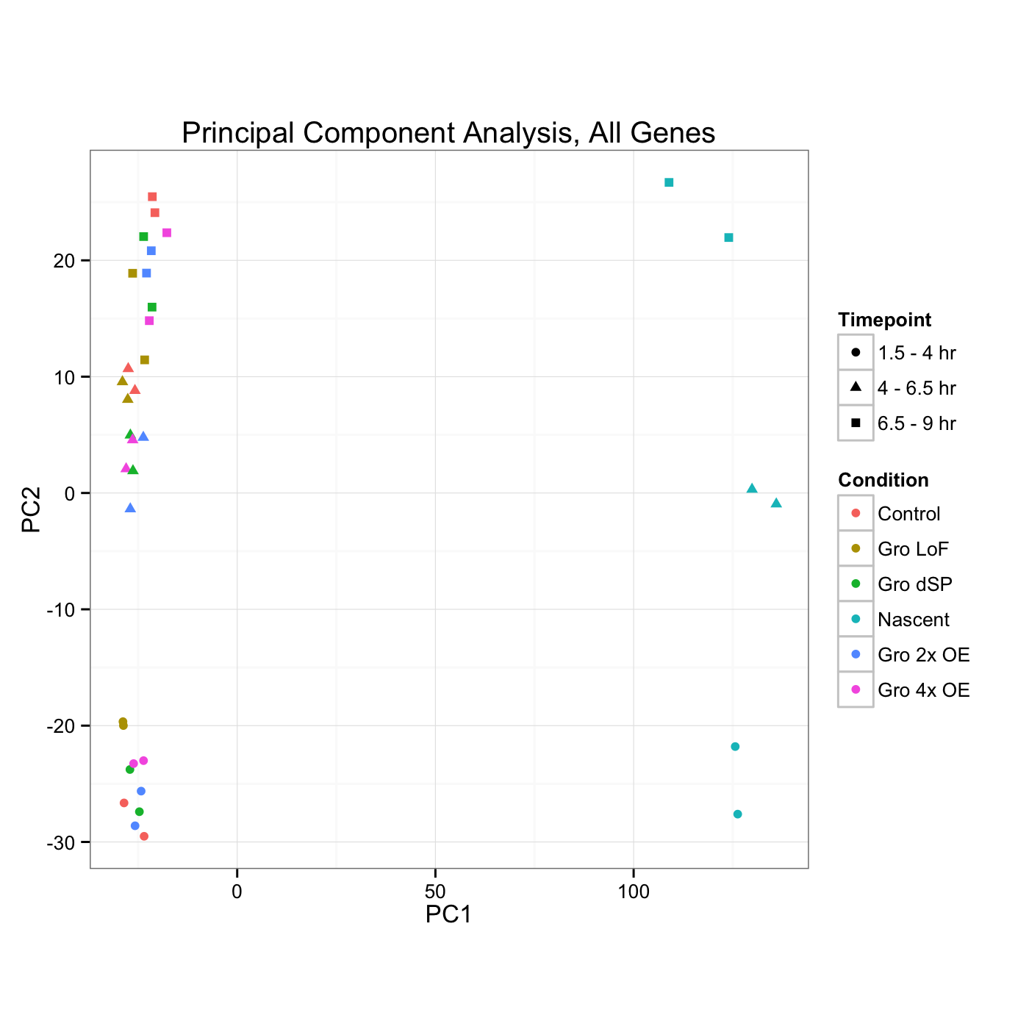
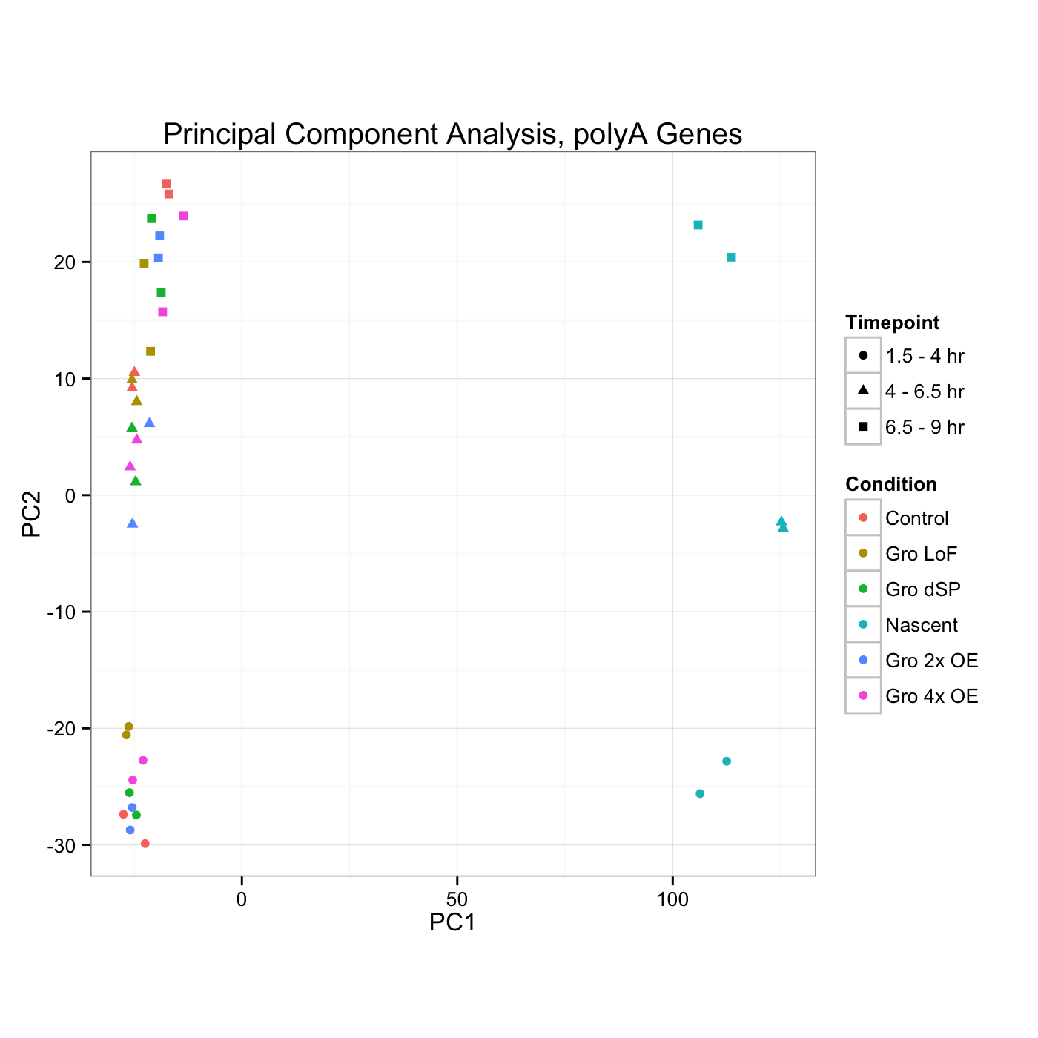
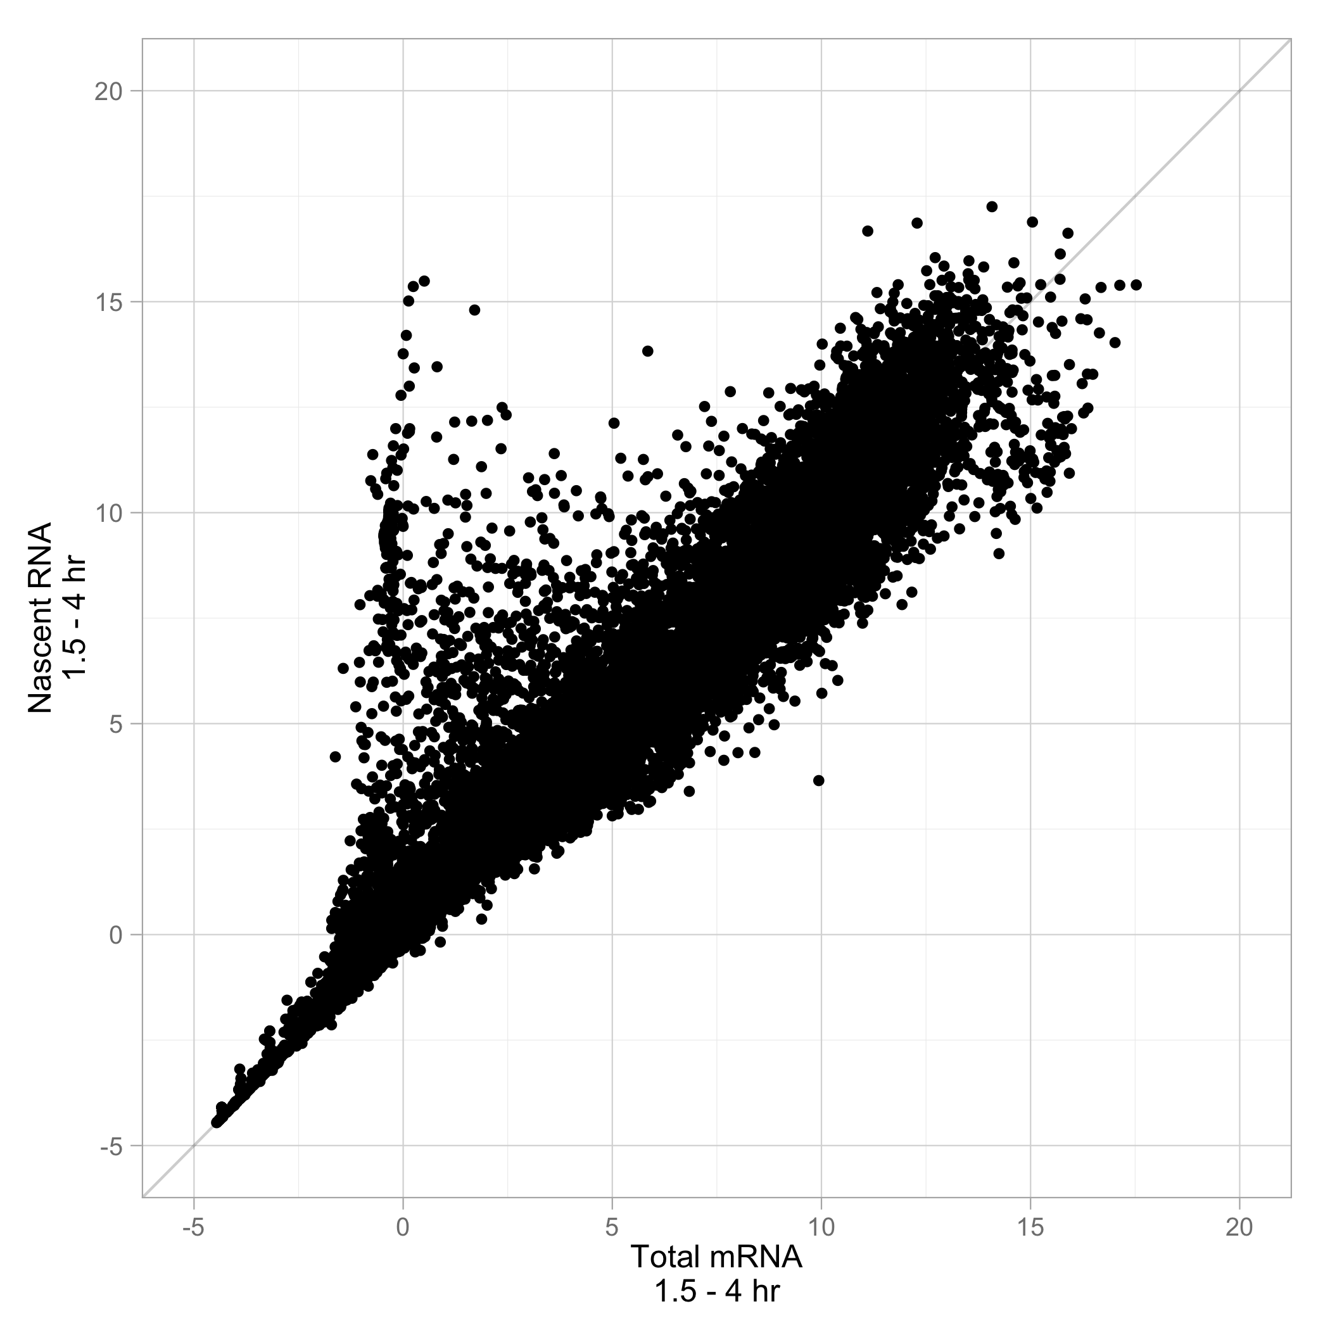
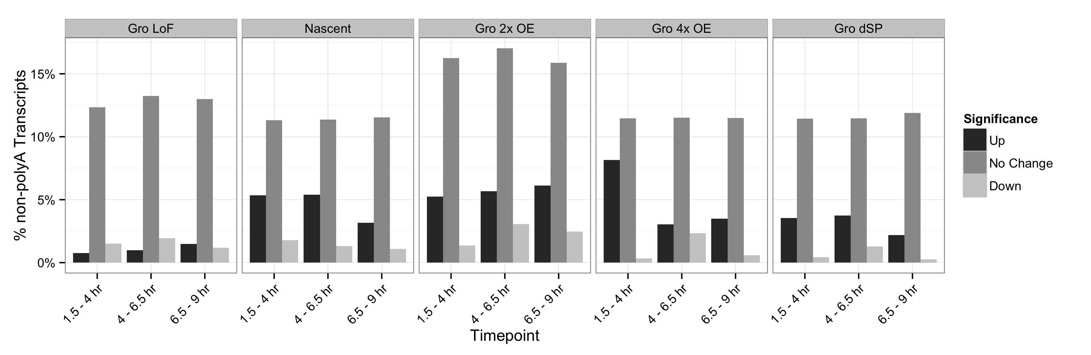
Nascent-seq reveals differences in mRNA abundance and transcription rates
Expression level (log normalized)
Notes:
Be careful in comparisons to "wild-type"
Replot and PCA w/o polyA transcripts
----- Meeting Notes (2/25/15 11:21) -----
Move nascent-seq to rna-seq (and conformation of transcription rates)
PCA analysis
Black lab paper for nascent-seq
----- Meeting Notes (3/2/15 15:03) -----
Characteristics of DE genes (potentially non-polyA)
What they call nascent-seq

Slide 18
Overview
Establishing a timeline of Groucho activity in early embryonic development
Investigating the dynamics of Groucho occupancy
Notes:
nascent-seq reads along gene

Slide 19
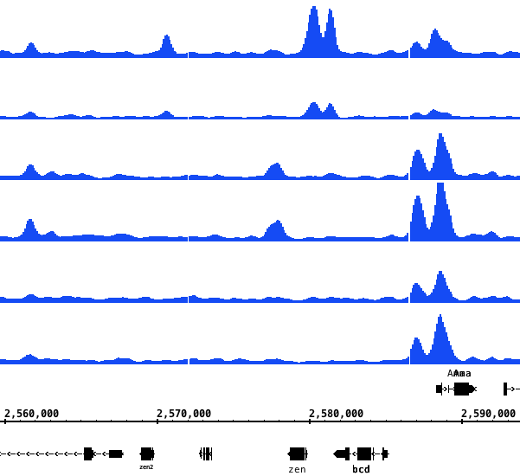
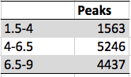
Groucho recruitment is more dynamic during early developmental stages
4 - 6.5 H
6.5 - 9 H
1.5 - 4 H
3056
1.5 - 4
1409
717
64
2311
782
4 – 6.5
6.5 – 9
zen2
zen
bcd
Notes:
Numbers should be bigger (a general problem)
Gene names should be bigger
----- Meeting Notes (2/25/15 11:01) -----
upstream of zen known ventral regulation
Two zen response elements upstream
Originally defined and perhaps "shadow" enhancer described by Levine
One replicate per timetpon
Transition to chip-seq should be smoother
Show multiple genomic loci
----- Meeting Notes (3/2/15 15:03) -----
Integrate macs2 bed file
zen ventral repression region (dorsal)

Slide 20
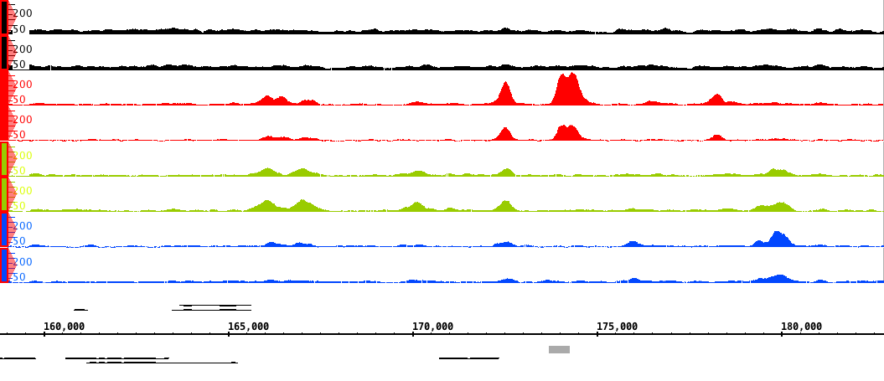
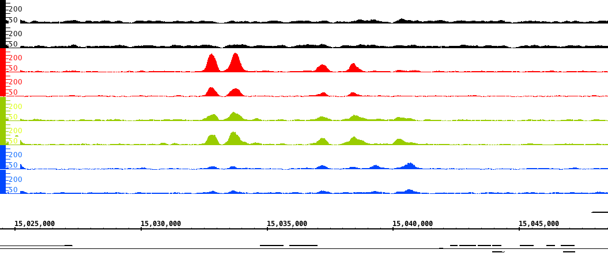
Groucho localizes to both enhancer and TSS elements of multiple Capicua-regulated genes
Input
1.5 - 4
4 – 6.5
6.5 – 9
(+)
(-)
hkb
*
Input
1.5 - 4
4 – 6.5
6.5 – 9
(+)
(-)
ind
Notes:
Potential evidence for looping
Search for Hi-C and chia-pet data
Levine hi-c on dorsal targets

Slide 21
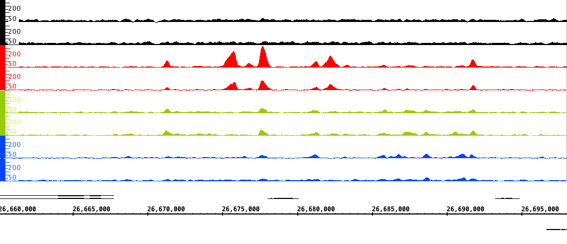
Groucho localizes to both enhancer and TSS elements of multiple Capicua-regulated genes
Input
1.5 - 4
4 – 6.5
6.5 – 9
tll

Slide 22
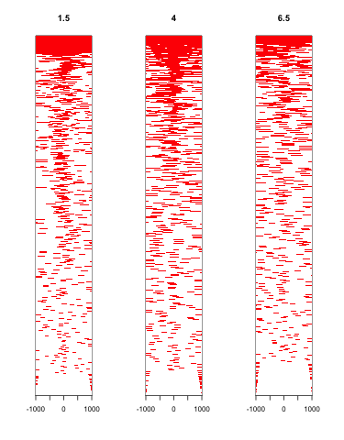
Groucho enrichment at TSS supports its role as a long- and short-range repressor
Notes:
Heatmaps to TSS (Adelman's paper)
All numbers bigger
----- Meeting Notes (2/25/15 11:01) -----
promoters to tss

Slide 23
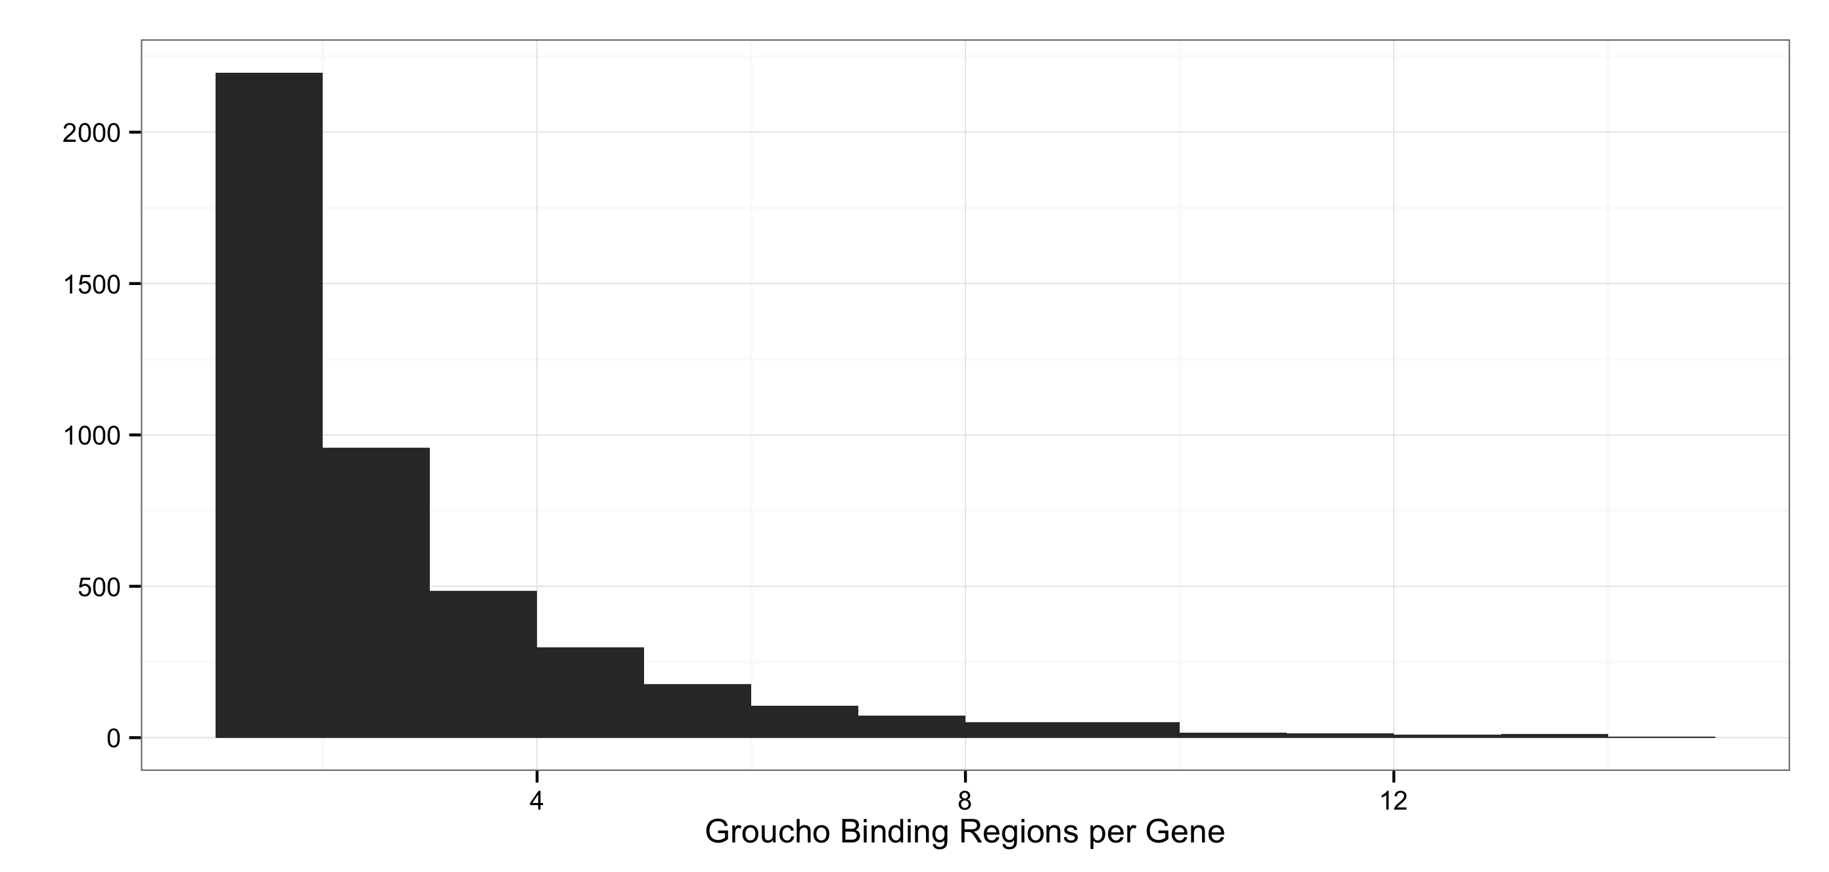
Groucho spreading is not an obligate feature of repression
Notes:
# of binding segments predictive of gro regulation???
Bring into focus into looping
"Now I'm going to introduce data about concept of spreading versus looping..."
----- Meeting Notes (2/25/15 11:01) -----
Gene
----- Meeting Notes (3/2/15 15:03) -----
Remove input
Remove pie chart
Replace w/ two genome views showing typical and spreading behavior

Slide 24
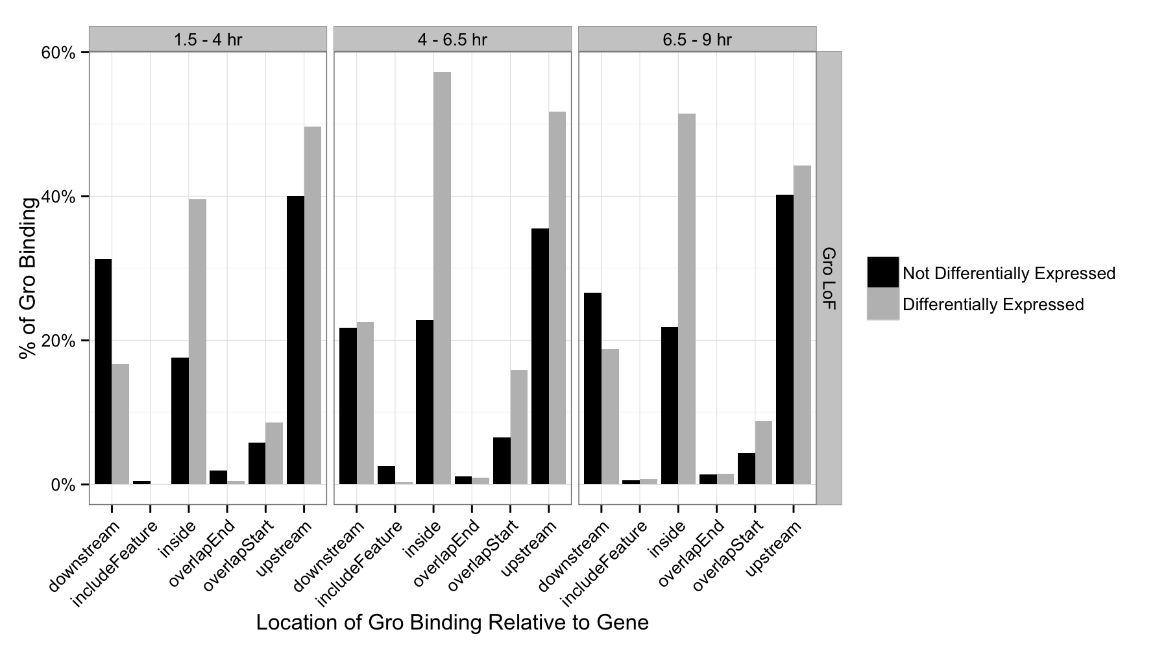
“Active” Groucho binding regions are enriched upstream and inside of genes

Slide 25
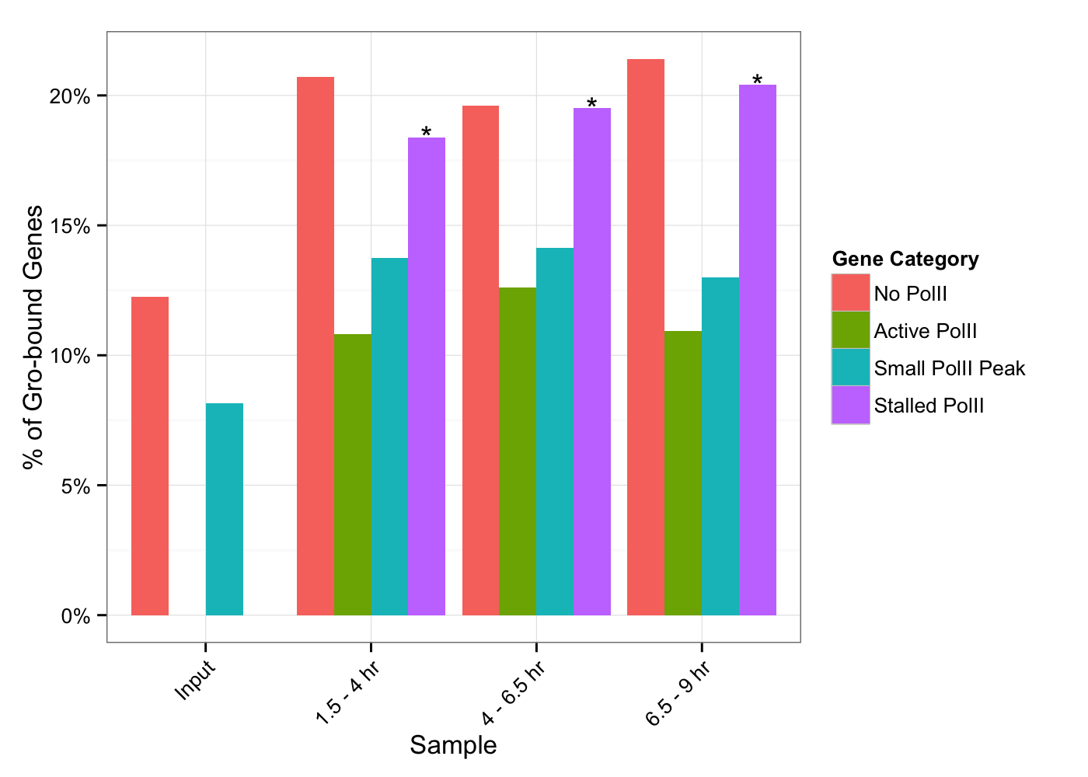
Groucho regulated genes are enriched for stalled PolII

Slide 26
Summary
Groucho is most likely a dedicated repressor in Drosophila
In embryos, mRNA abundance is largely but not completely proportional to transcription rate
Groucho may be delivered to promoter regions by repressive elements, where it remains
While Groucho can bind to large regions of the genome, spreading appears to be limited
Notes:
----- Meeting Notes (3/2/15 15:03) -----
Gro dedicated repressor
Largely but not completely explained by transcription rate
Groucho may be delivered to promoters by repressive elements where it remains
Gro spreading is limited

Slide 27
Acknowledgements
Courey Lab
Dr. Al Courey *
Wiam Turki-Judeh *
Mitchell Kim *
Kenny Chen *
Pak Kwong
Joseph Cao
Collaborators
Sean Gallaher (Merchant Lab)
Kelvin Zhang (Zipursky Lab)
Committee
Dr. James Bowie
Dr. Mike Carey
Dr. Cathy Clarke
Dr. Volker Hartenstein
Notes:
----- Meeting Notes (5/30/13 13:03) -----
Matteo Pellegrini
----- Meeting Notes (3/20/14 11:01) -----
5'cap RACE
5' capping
phosphatase
then
pyrophosphatase

Slide 28
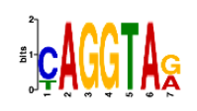
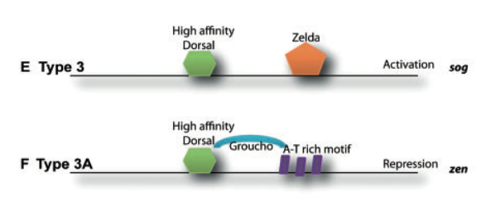
Early Groucho binding regions are enriched for Zelda sequence motifs
189
From Chopra et al, 2009
?

Slide 29
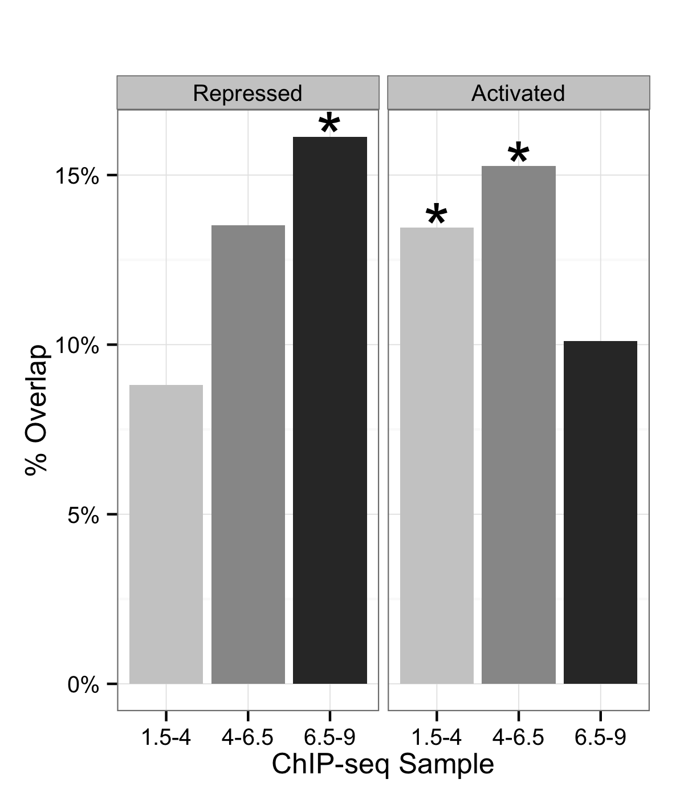
Genes with adjacent Groucho binding sites are enriched for putative Gro repression
* p-value < 0.01
Notes:
Confusing Groucho activation/repression teminology
----- Meeting Notes (3/2/15 15:03) -----
Add p-value
Include only LoF data

Slide 30
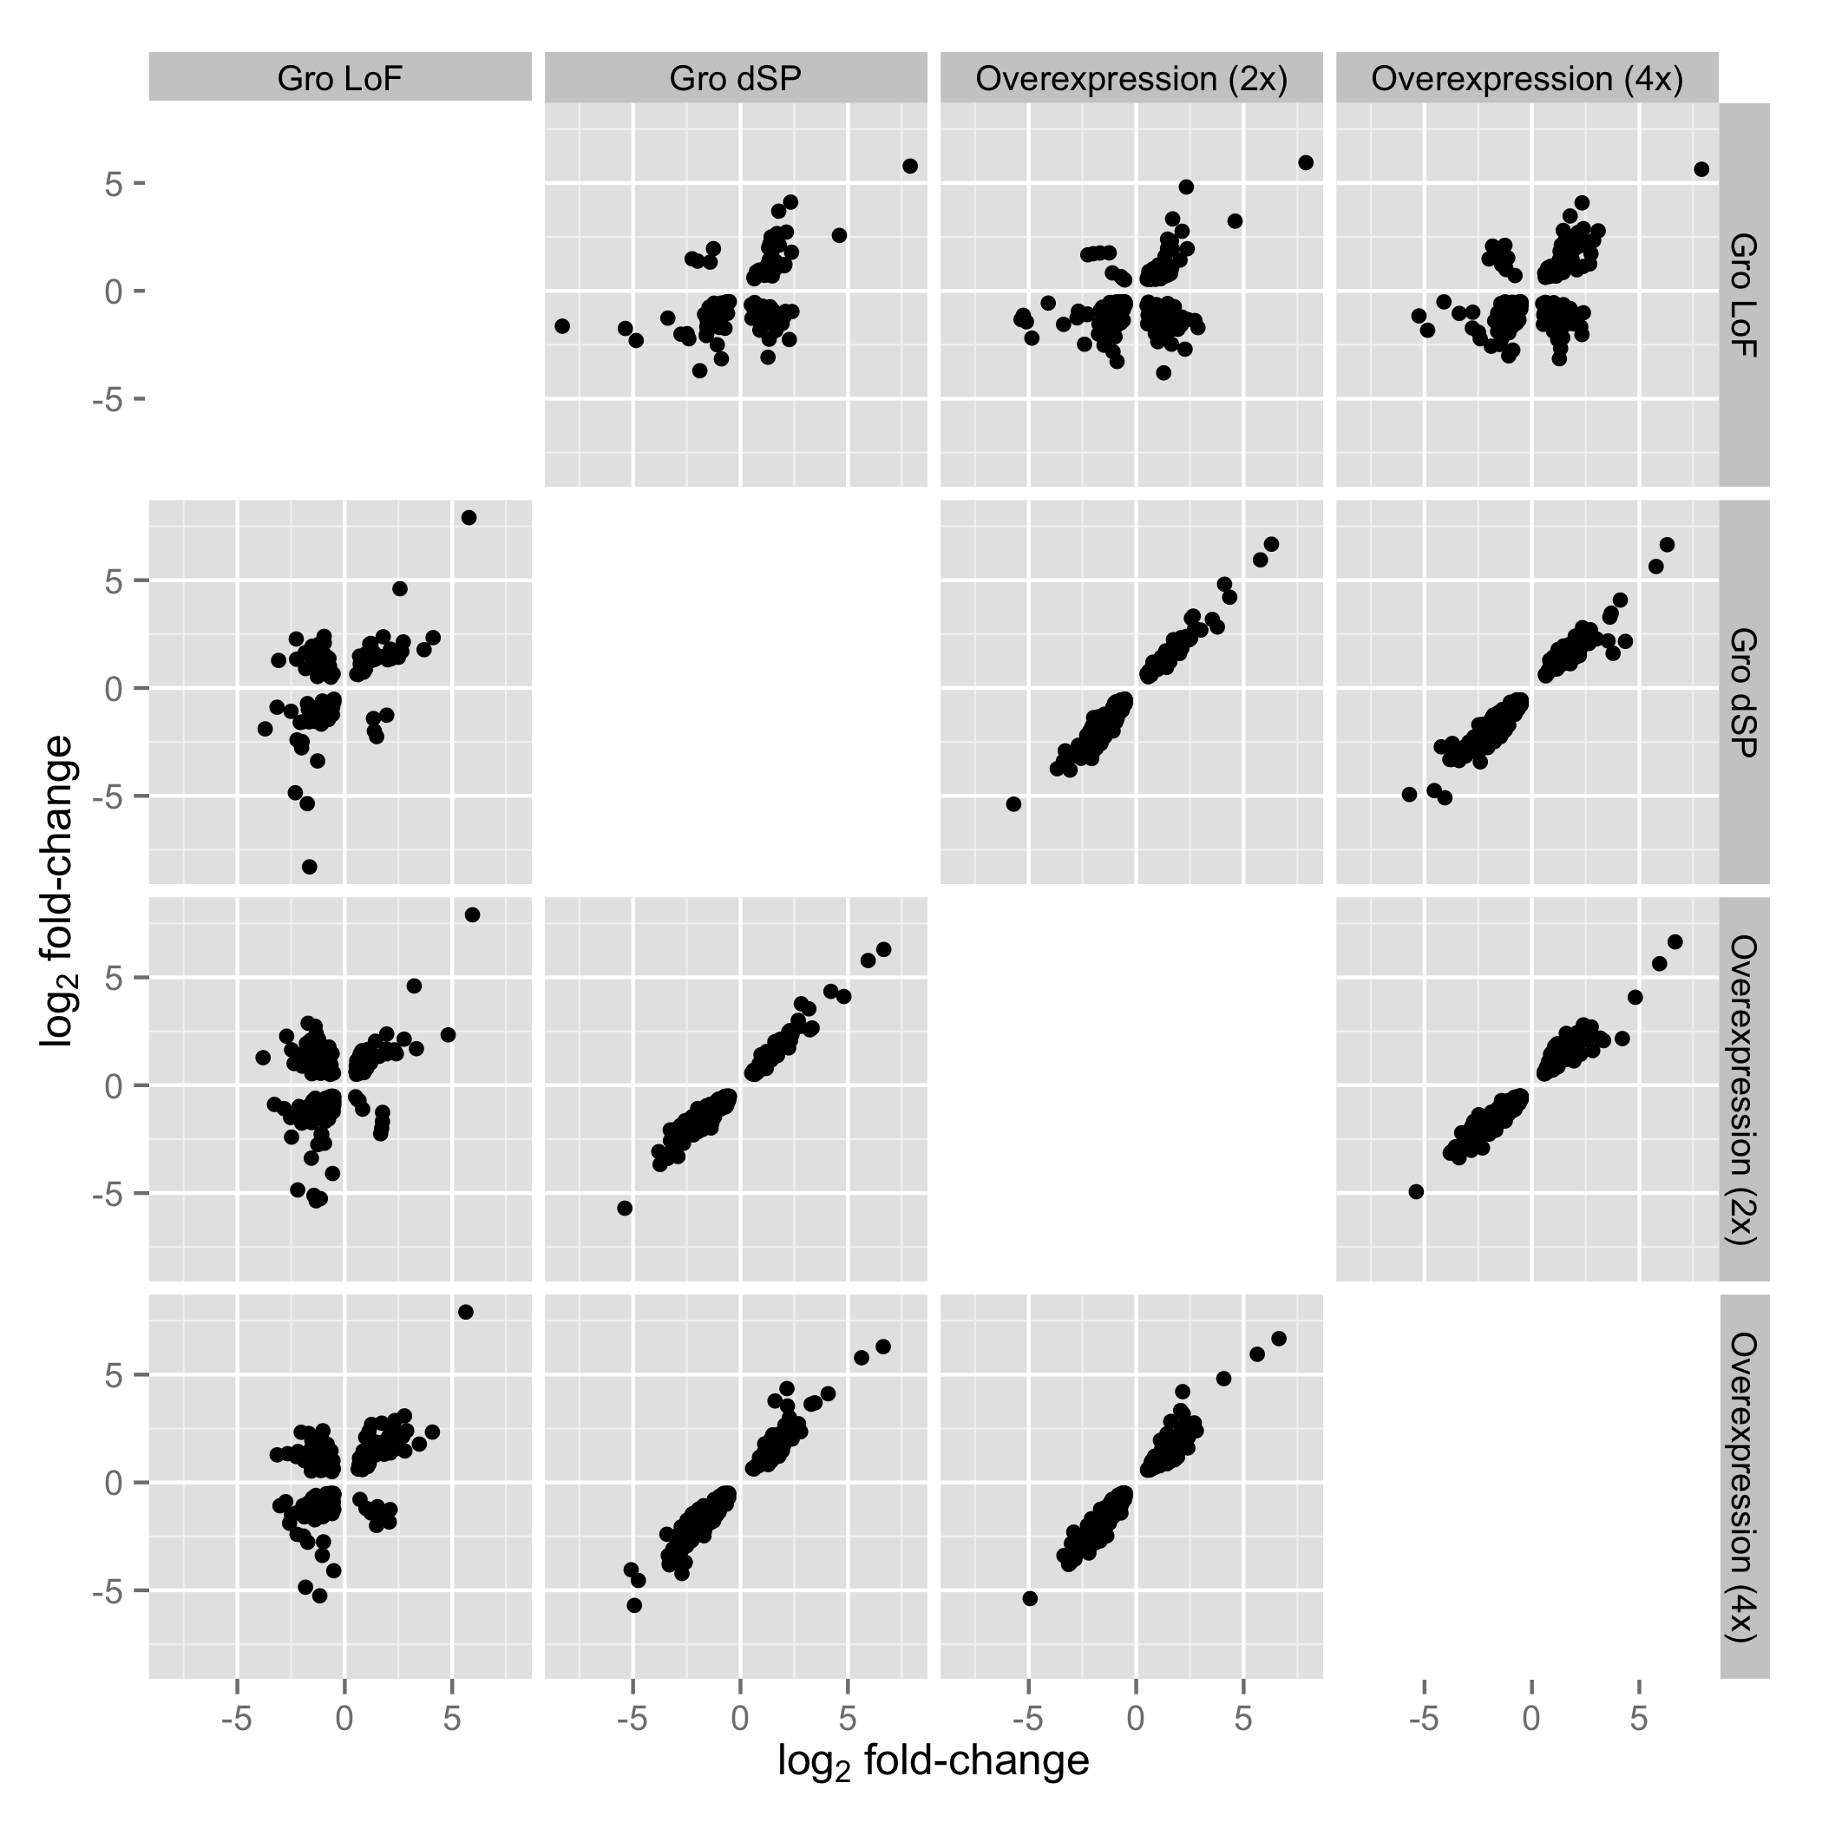
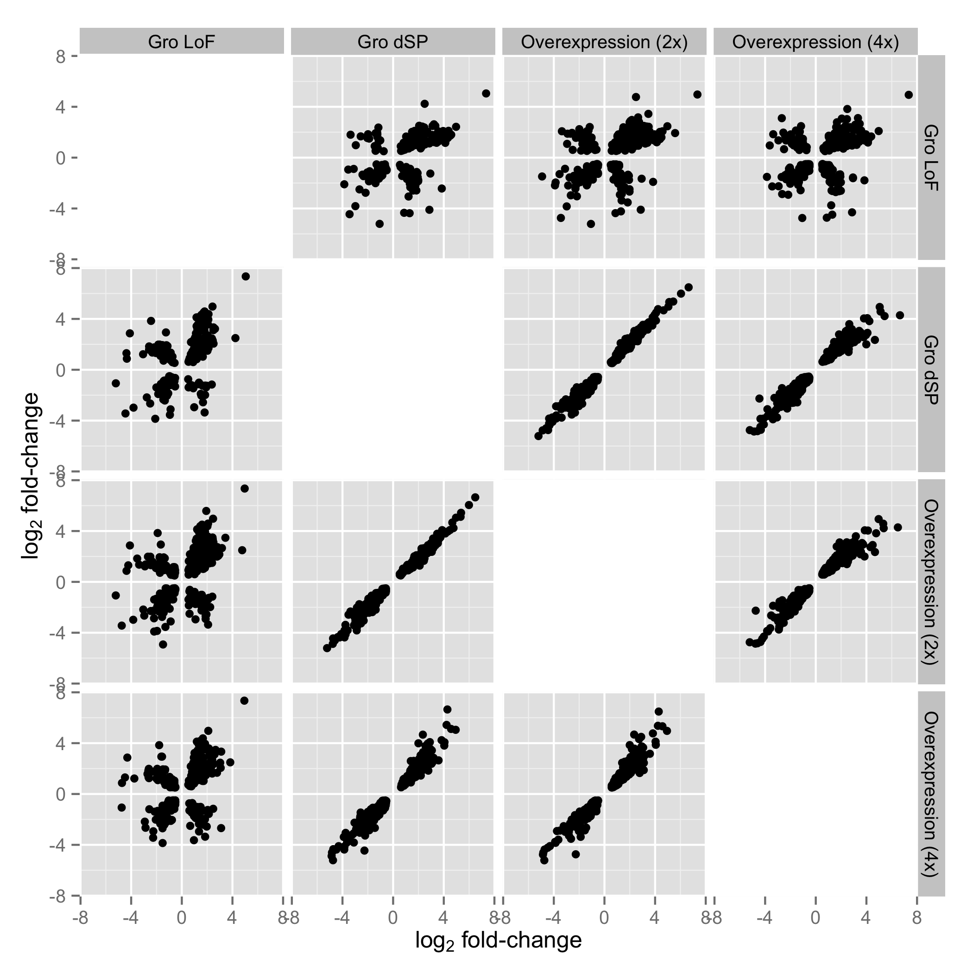
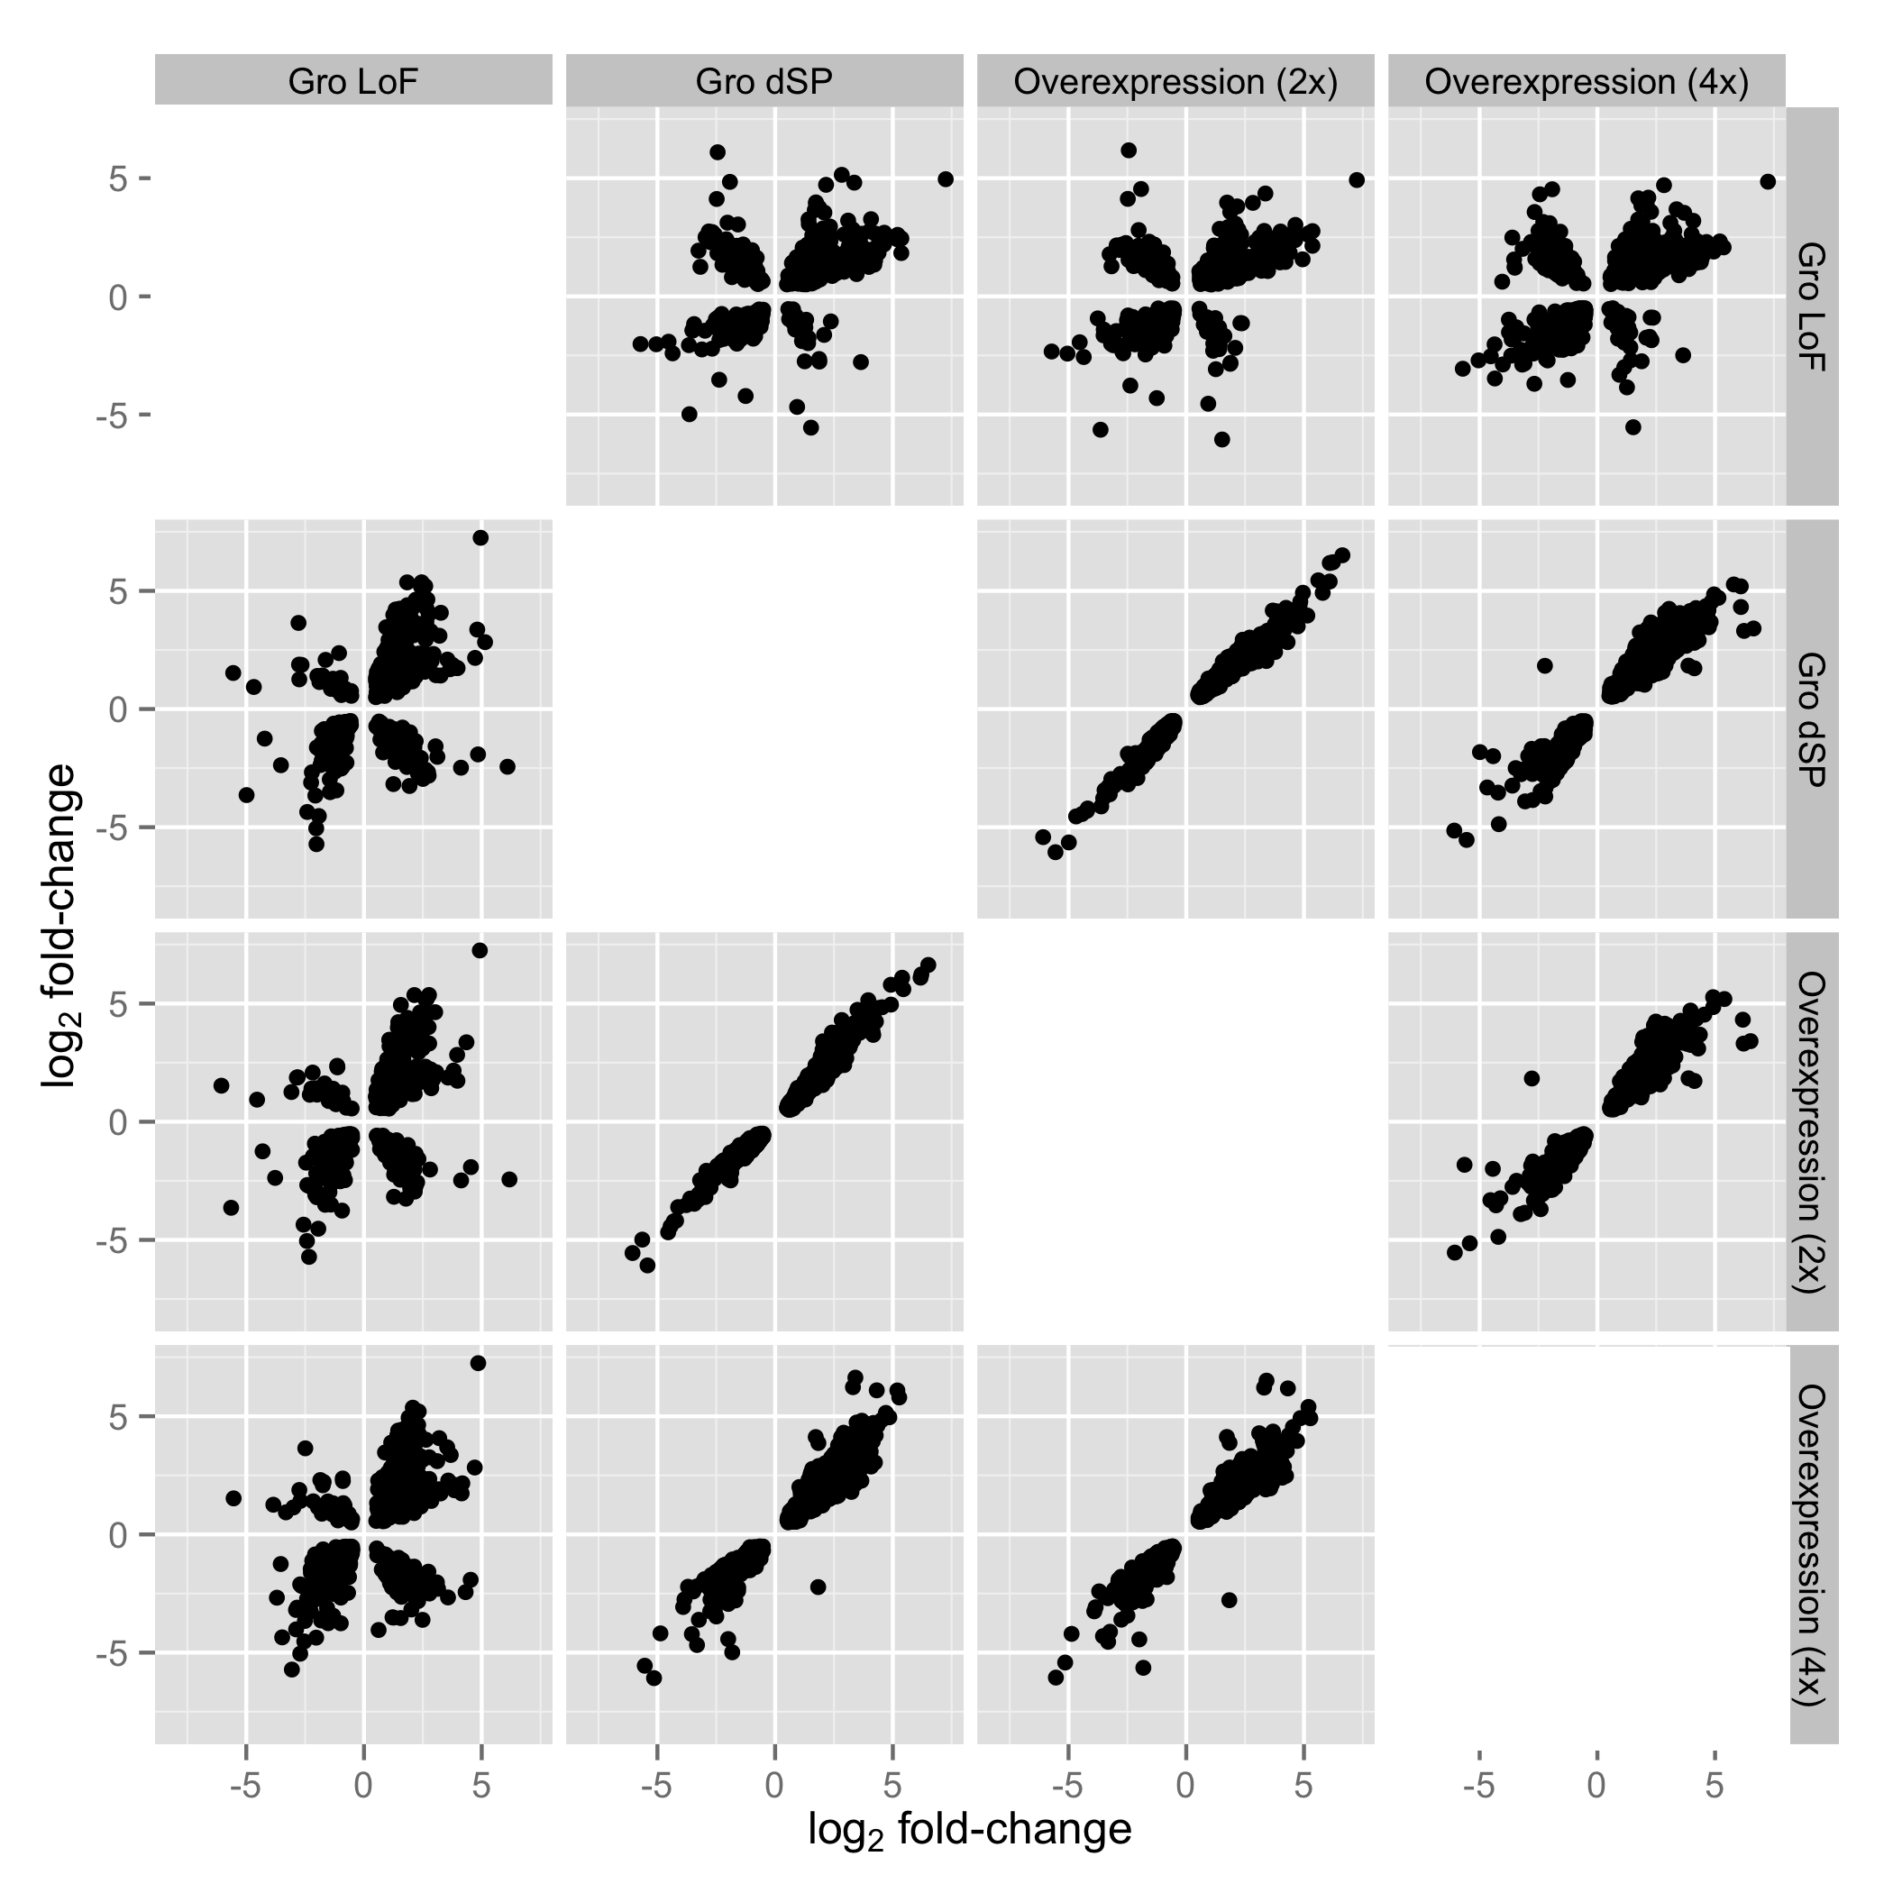
1.5 – 4 hr
4 – 6.5 hr
6.5 – 9 hr

Slide 31
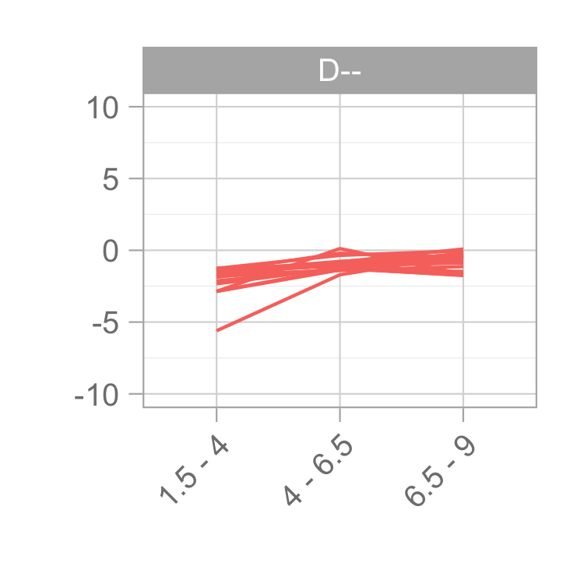
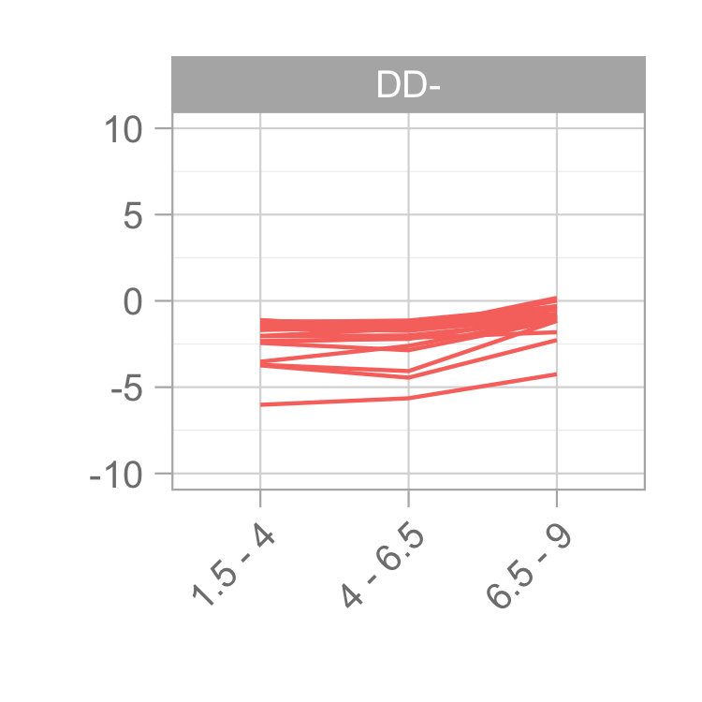
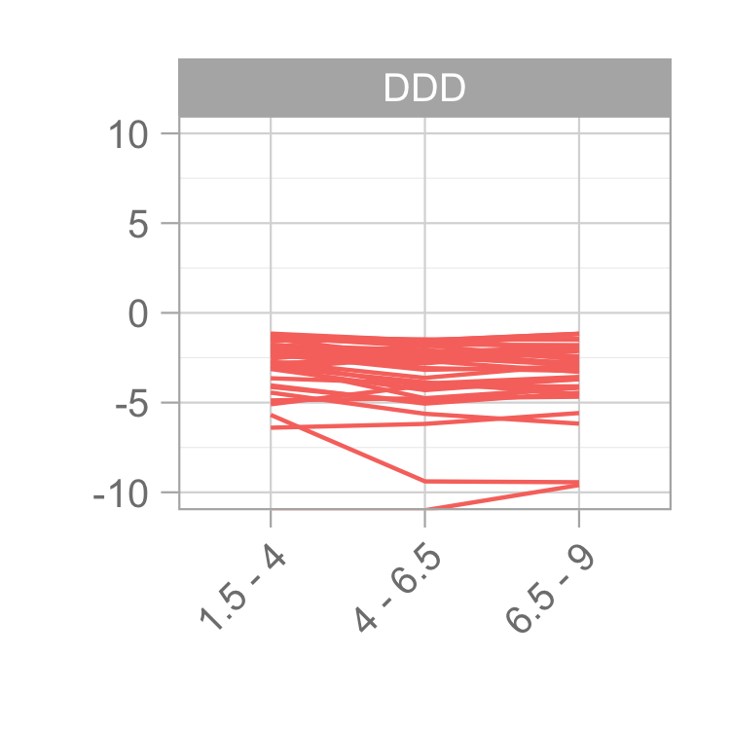
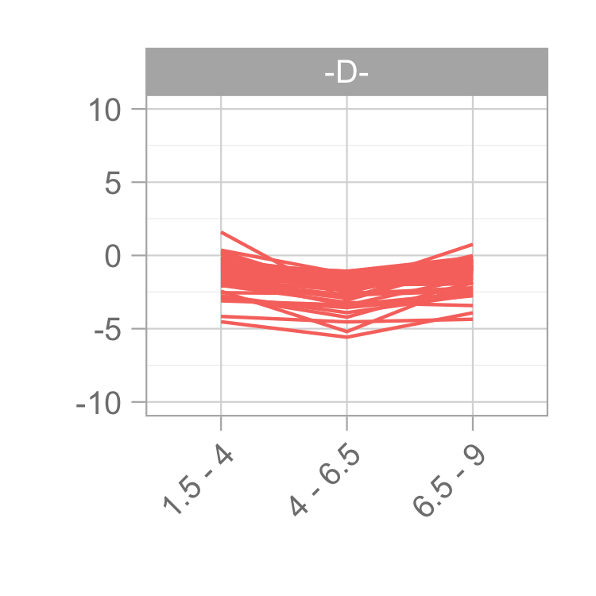
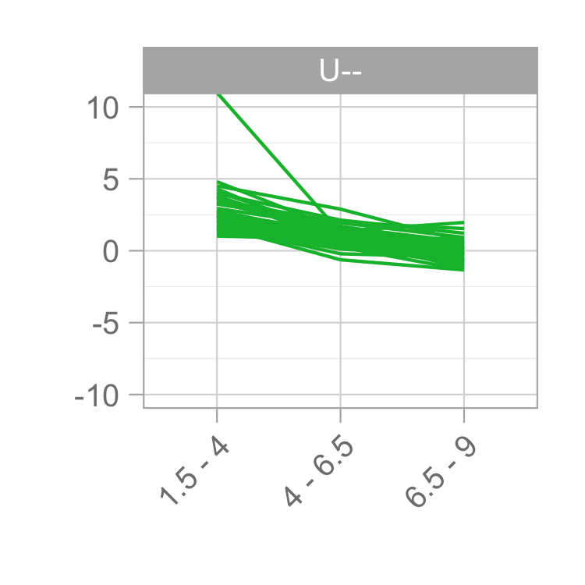
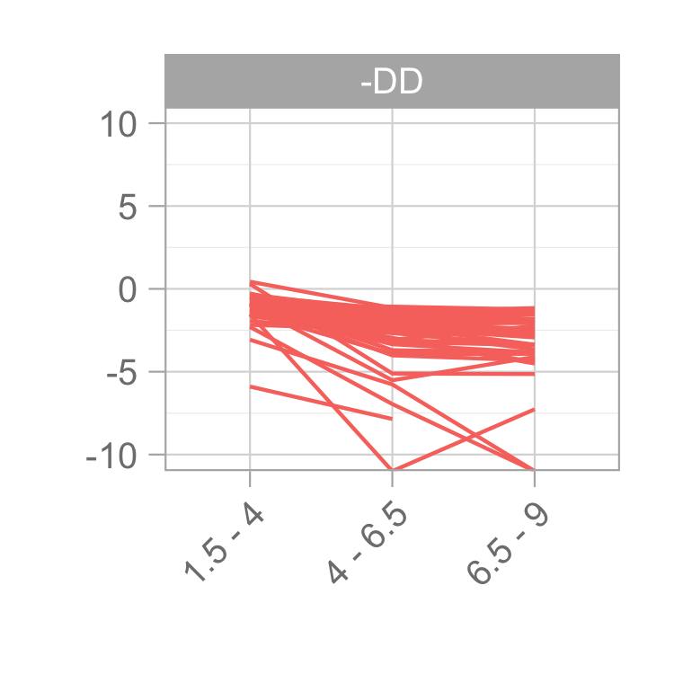






Clustering of misregulated genes reveals multiple regulatory paradigms
H3K27me3
log₂ fold-change
H2BK5ac
H4K8ac
H3K27ac
H3K18ac
Notes:
----- Meeting Notes (2/25/15 11:01) -----
repressed or activated vs down/up
heatmap

Slide 32


Slide 33


Slide 34




